Slide 1
Valuing Education & Industry Partnerships
Western provides equal opportunity in education and employment. Learn more: westernwyoming.edu/NDS

Slide 2
Meet Your Presenter
Amy Murphy
Dean, Outreach and Workforce Development
Western Wyoming Community College

Slide 3
Experience with Developing Collaborative Programs with Industry
Industrial Maintenance
Diesel Technology
Plant Operations
Electrical and Instrumentation Technology
Many more, but the most recent…
POWERLINE TECHNOLOGY

Slide 4
Powerline Technology Overview
^{Union Wireless}
^{Lisa Jones}
^{Matt Myers}
^{Megan Neal}
Utility Workers Union of America
^{Chauffe Schirmer}
^{Western Wy. Community College}
^{Lance Caldwell}
^{Dr. Kim Dale}
^{Carlton Dewick}
^{Amy Murphy}
^{Dr. Cliff Wittstruck}
Wyoming Rural Electrical Association
^{Shawn Taylor}
^{Black Hills Energy}
^{Laurie Farkas}
^{Damien Parks}
^{Alan Stoinski}
^{IBEW}
^{Scott Long}
^{Mark Maumau}
^{Kevin Owen}
^{Carl Woodland}
^{Intermountain Electric}
^{JD Hall}
^{Lower Valley Energy}
^{Brian Tanabe}
^{Rocky Mountain Power}
^{Chris Nelson}
^{Ray Summa}
^{Ron Wild}
Meeting with Key Personnel

Slide 5
Program Mission
To ensure the demand for skilled linepersons are met, and at the same time, the required essential skills have been embedded.

Slide 6
Program Curriculum
Reviewed existing curriculum
Designed some new courses
Repackaged into new program

Slide 7
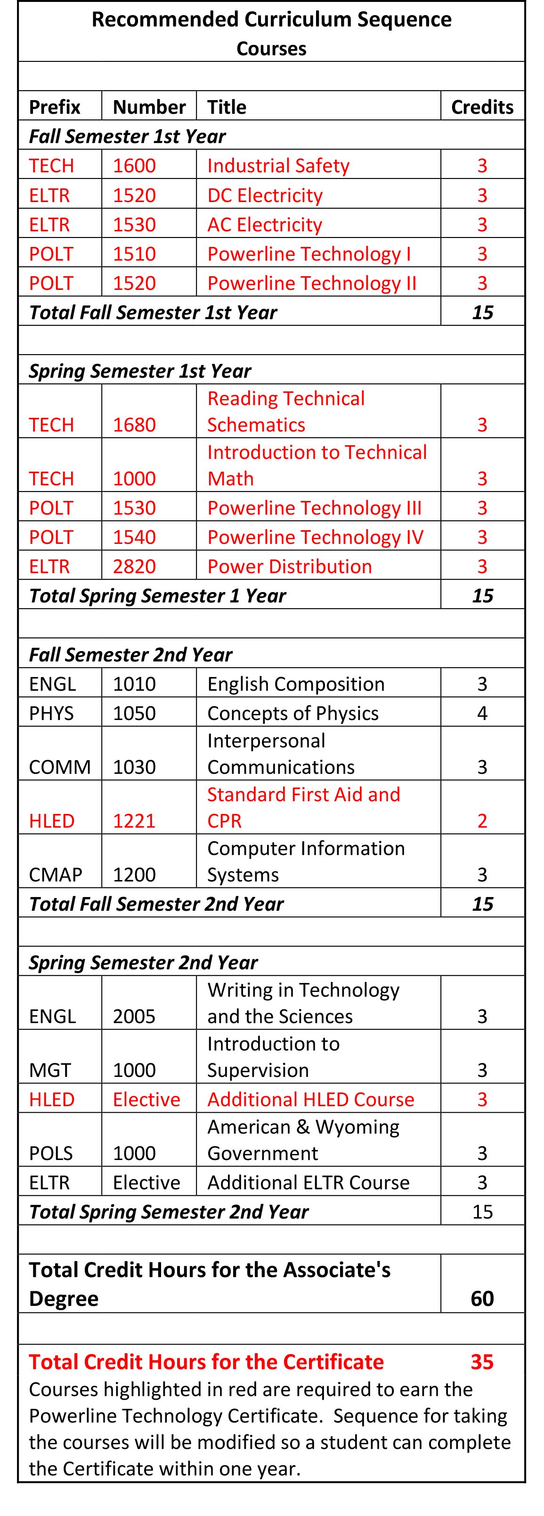
Program Curriculum

Slide 8
Program Goals
Challenging Careers
Stable Careers
Careers with Growth Opportunity
Well-Paying Careers
Local Careers

Slide 9
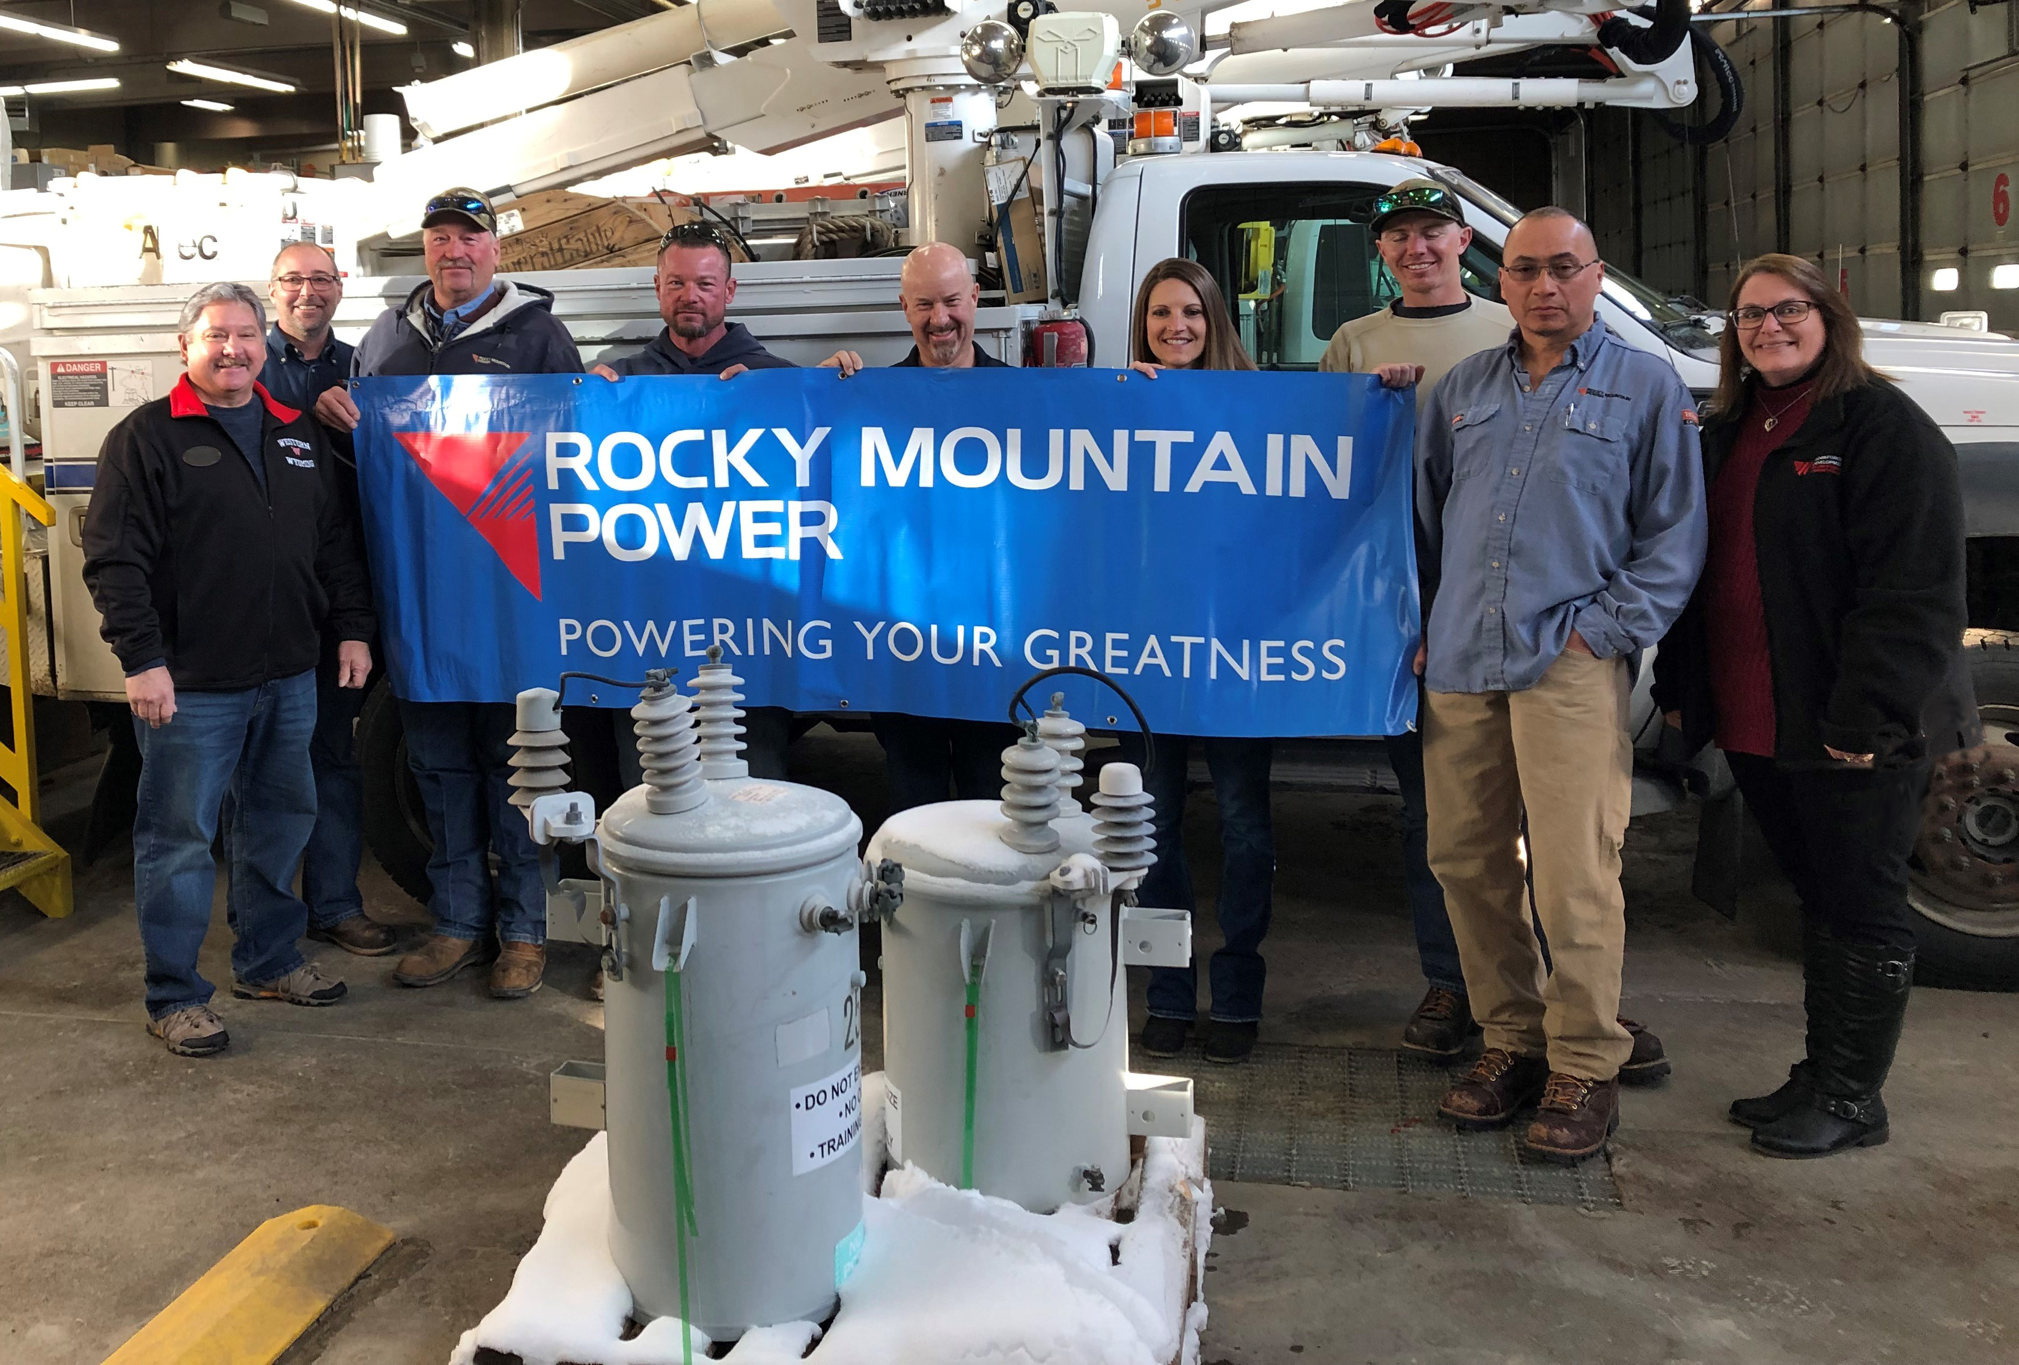
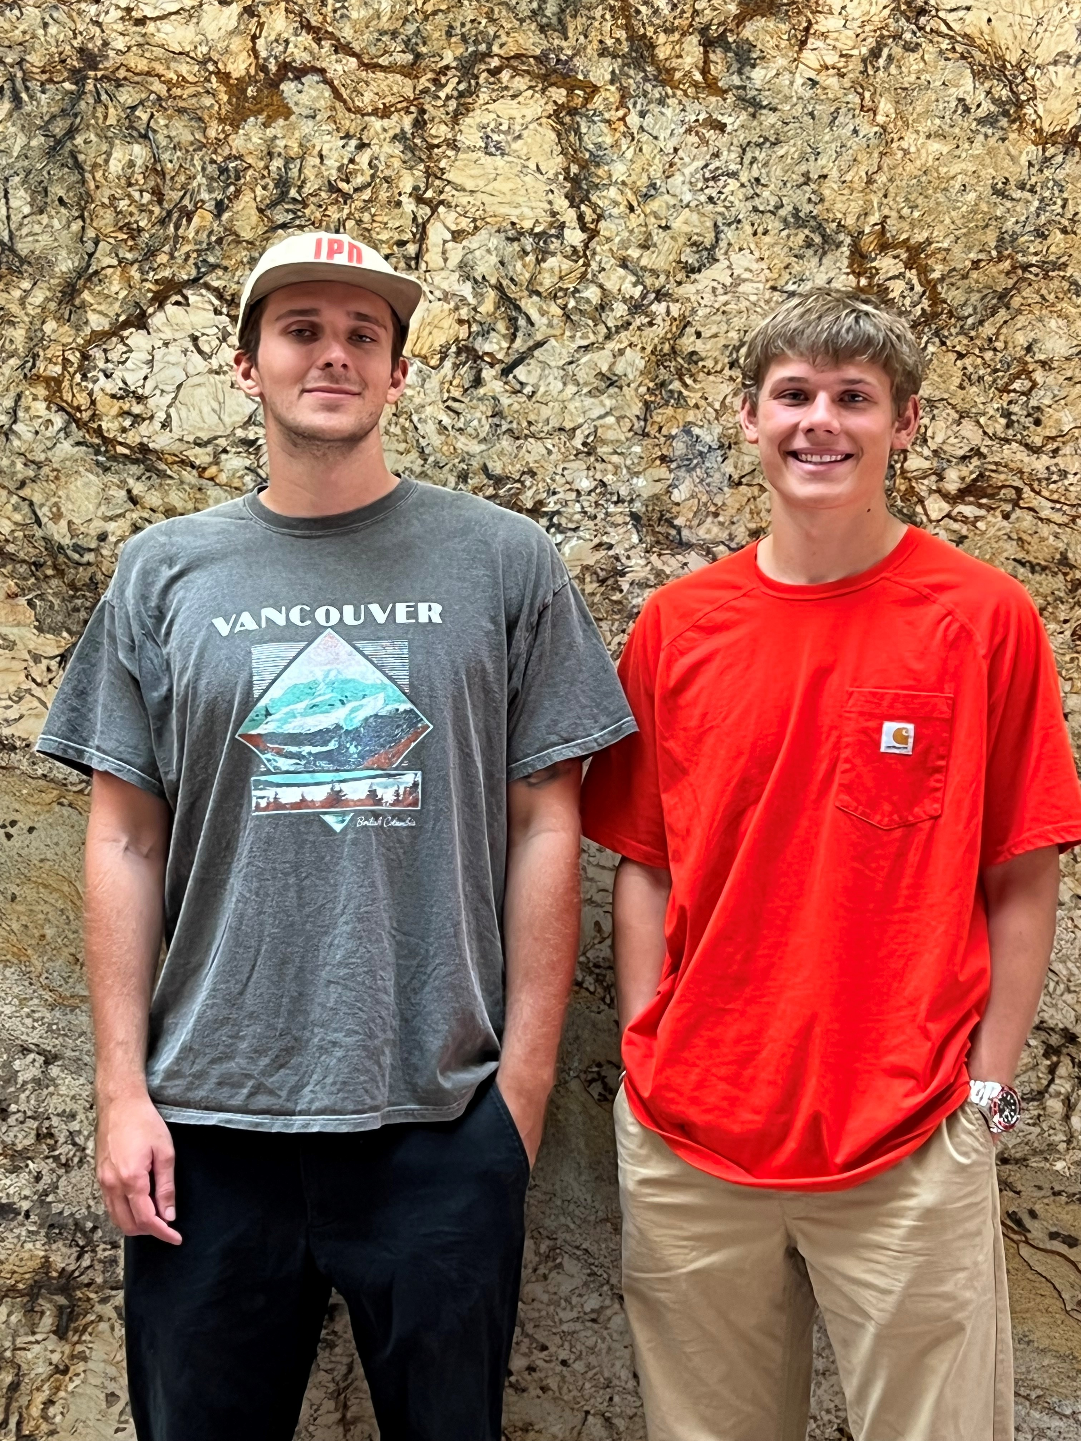
Key to the Program Corporate/Government Partners

Slide 10
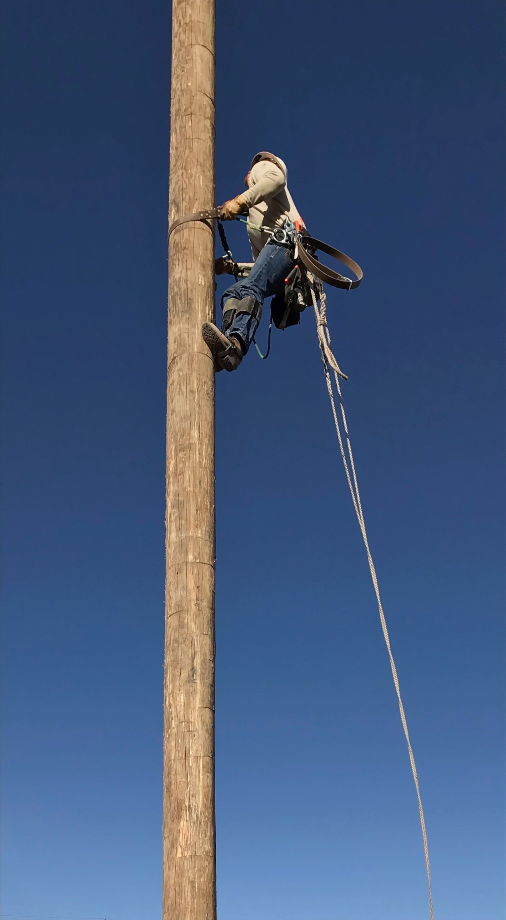
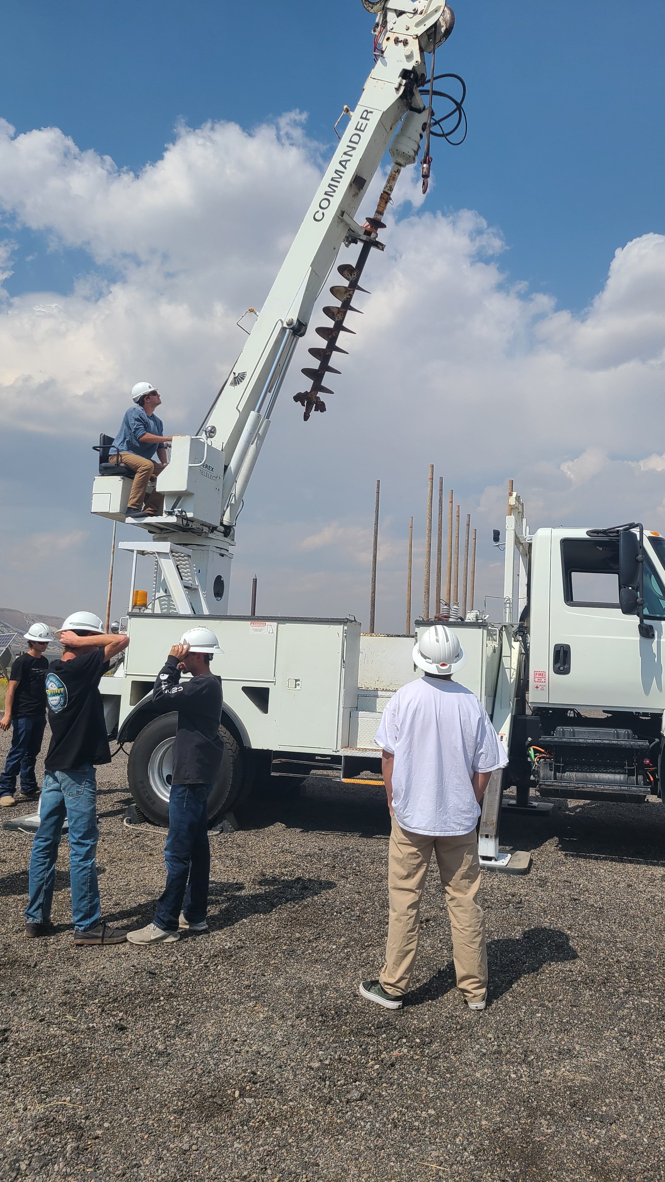
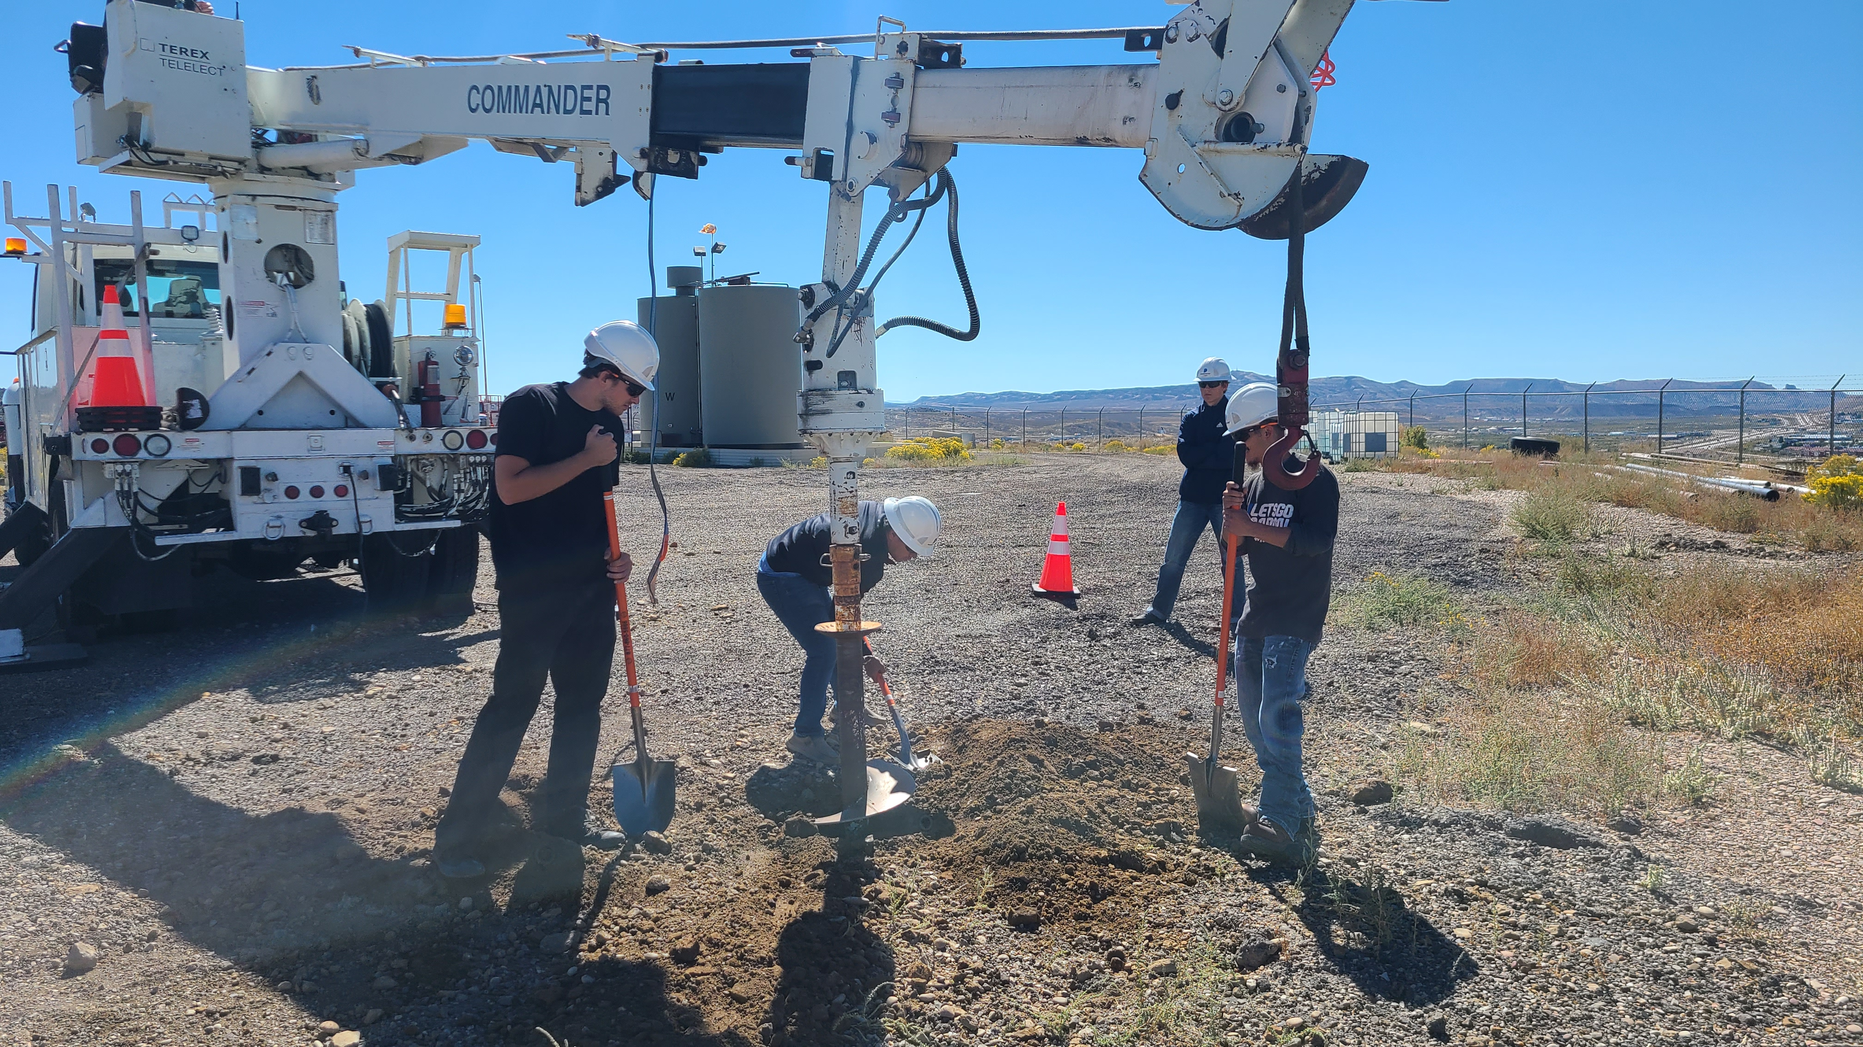
Continuous Quality Improvement
ADVISORY BOARD

Slide 11
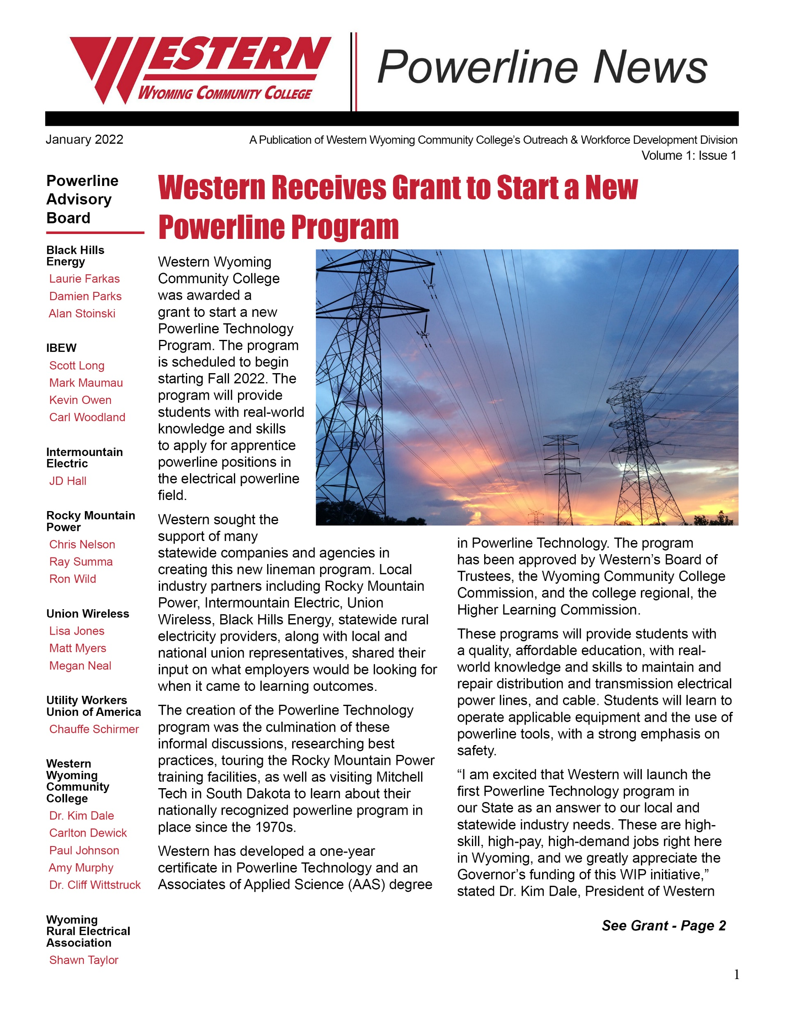
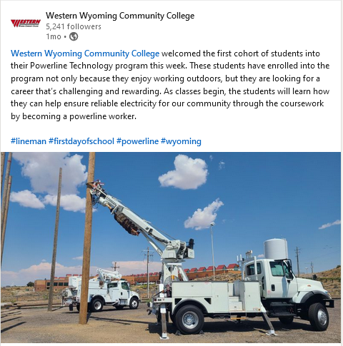
Marketing/Promotion
Methods of communication
include print and digital

Slide 12
Replicate our Success
Know Your Community and their Workforce Needs
Identify the Key Partners
Develop Relationships and Strategies
LISTEN to Your Employer Needs
Communicate, Communicate, Communicate
Implement Program and Marketing Plan
Obtain Feedback and Continuous Quality Improvement

Slide 13
Contact Information
Amy Murphy
Dean, Outreach & Workforce Development
amurphy@westernwyoming.edu
(307) 382-1616

