Slide 1
Cooperatives Create Local Solutions by Local People
Davey Madison
Program Director, Montana Cooperative Development Center
Notes:
I’d like for you to be able to use some examples from Montana communities, even if it’s “these are some places that are working on implementing these.” And I do think that highlighting child care cooperatives along with the opportunity development coops, maybe under an umbrella like: “here’s how communities can use cooperatives to create community-led workforce solutions" would be especially useful. You could even mention workforce housing cooperatives, but not dwell on that because we don’t want to repeat the Housing Solutions Roundtable.
So you could talk about:
1) what cooperatives are (specifically these types of coops)
2) how communities can and do use these types of cooperatives to tackle issues related to workforce.
3) how to get the conversation going/who the partners can be
4) some Montana communities have already started down the road to creating coops that help to address workforce challenges. For example, in Gardiner, a group of (business owners?) is working on a workforce housing land trust. In Baker, they are working to organize a childcare coop and an opportunity development coop to do X. And MCDC collaborated with Year Zero on a pilot focused on child care, and there are X communities now exploring coops.
5) In November, we expect to have our childcare coop resource toolkit ready.
6) Here are some other resources, and by the way, the laws in WY and ID are a little different.

Slide 2
Montana Cooperative Development Center

Slide 4
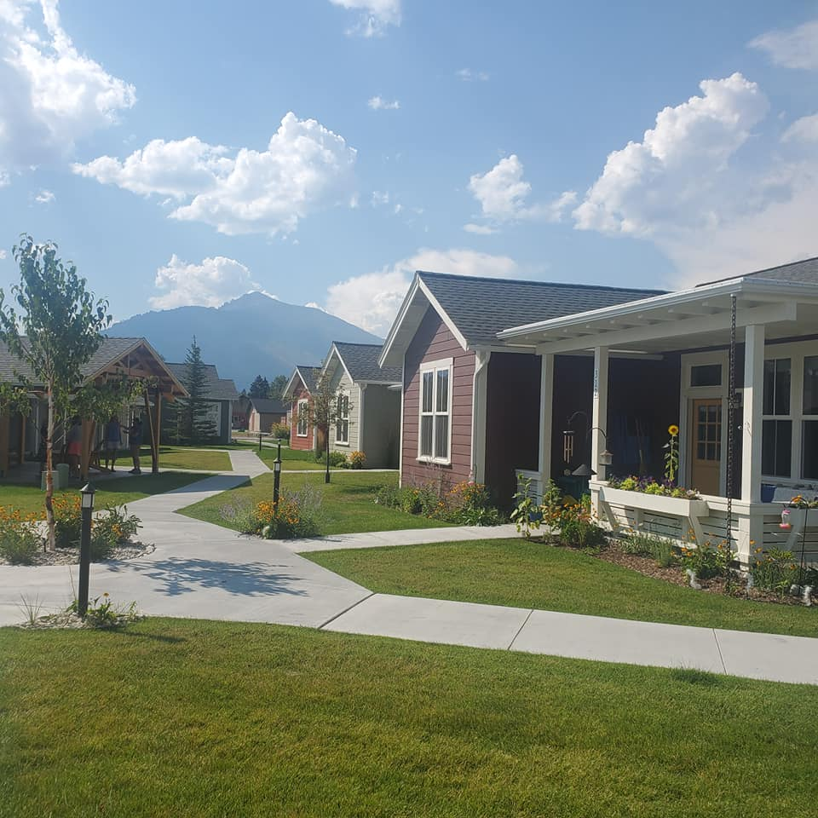
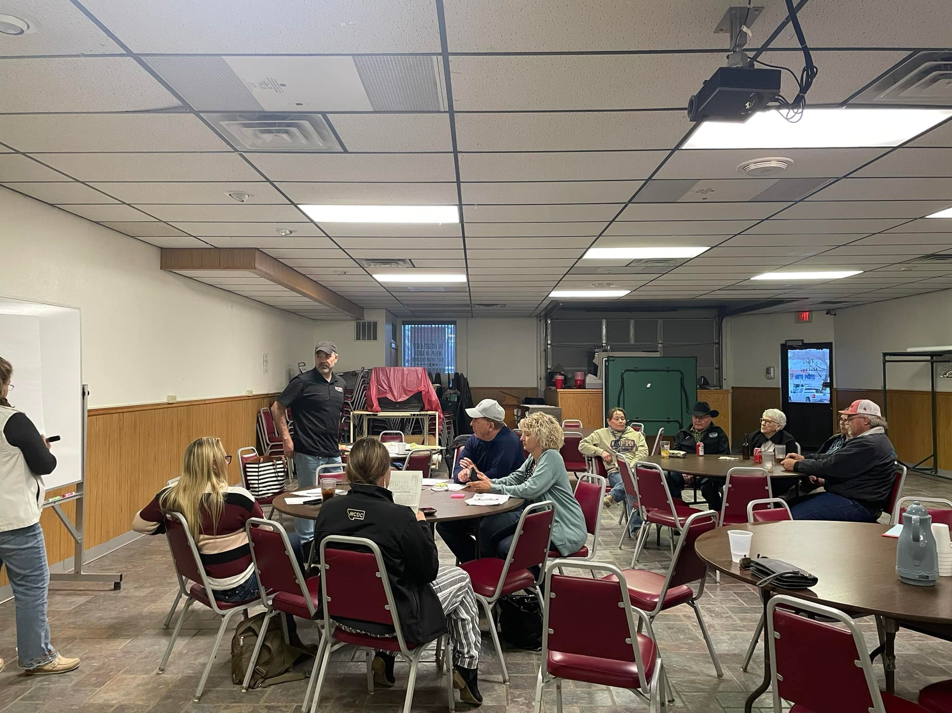
Cooperative Solutions

Slide 5
Ready to form a Co-op? Call us!

