Slide 1
Workforce Solutions Roundtable
Photo by Tammy Rudd – Imveverte, WV
Photo by Zohair Mirza
Notes:
Intro
Today, we’re talking about one of the most complex rural challenges: our workforce.

Slide 2
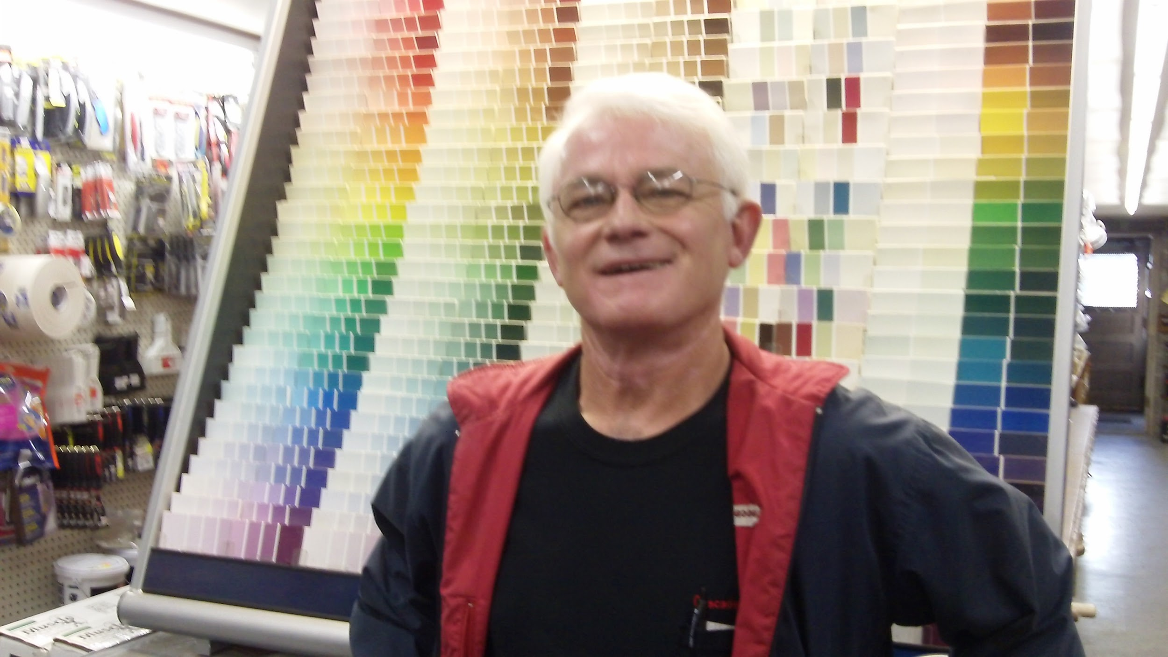
Population is smaller
More elderly people
More disability
More addiction
Lower education rates
Less people working
Photo by Becky McCray
Notes:
Workforce is a huge deal
Workforce consistently is one of the top 5 on our survey of rural challenges. Lots of different factors contribute to our ongoing workforce shortage.
Rural areas have a tighter labor supply because we’re rural. Our total population is smaller, with older people, more disability, more addiction, lower education rates and lower rates of participation in the workforce than in the more urban areas. Of course, rural employers struggle to fill job openings!

Slide 3
Get rid of limiting beliefs
Notes:
Get rid of limiting beliefs
Given how big of a mess this still is, the ways we have been trying to solve workforce issues have not been working, or not working well enough. We’ve all seen companies struggling with workforce challenges for decades now.
Right now and potentially for a long time, there’s another complication with the impact of COVID on our workforce. More women and older workers left the workforce, more people work remotely, a mental health crisis is brewing in the workplace, and young people are entering the workforce with a different communication style, a bit more reticent from years of remote schooling and work.
There are good ideas out there, things that can help address workforce challenges and improve your local economy. We’ve collected a lot of ideas from our travels to small towns, our Survey of Rural Challenges and listening to rural people like you. Too often, when we suggest one of these ideas to a struggling employer, they might respond with limited beliefs like:
“We post jobs, but no one applies!”
“The few who do apply just aren’t qualified!”
“We can’t afford to pay better!”
And several more we’ll talk about today.
Because workforce issues have been a problem for so long, it’s easy to see how some people have developed these limiting beliefs over time.
But remember, things are changing. By the end of this video, you will see that many of the old limits don’t have to be limits anymore.

Slide 4
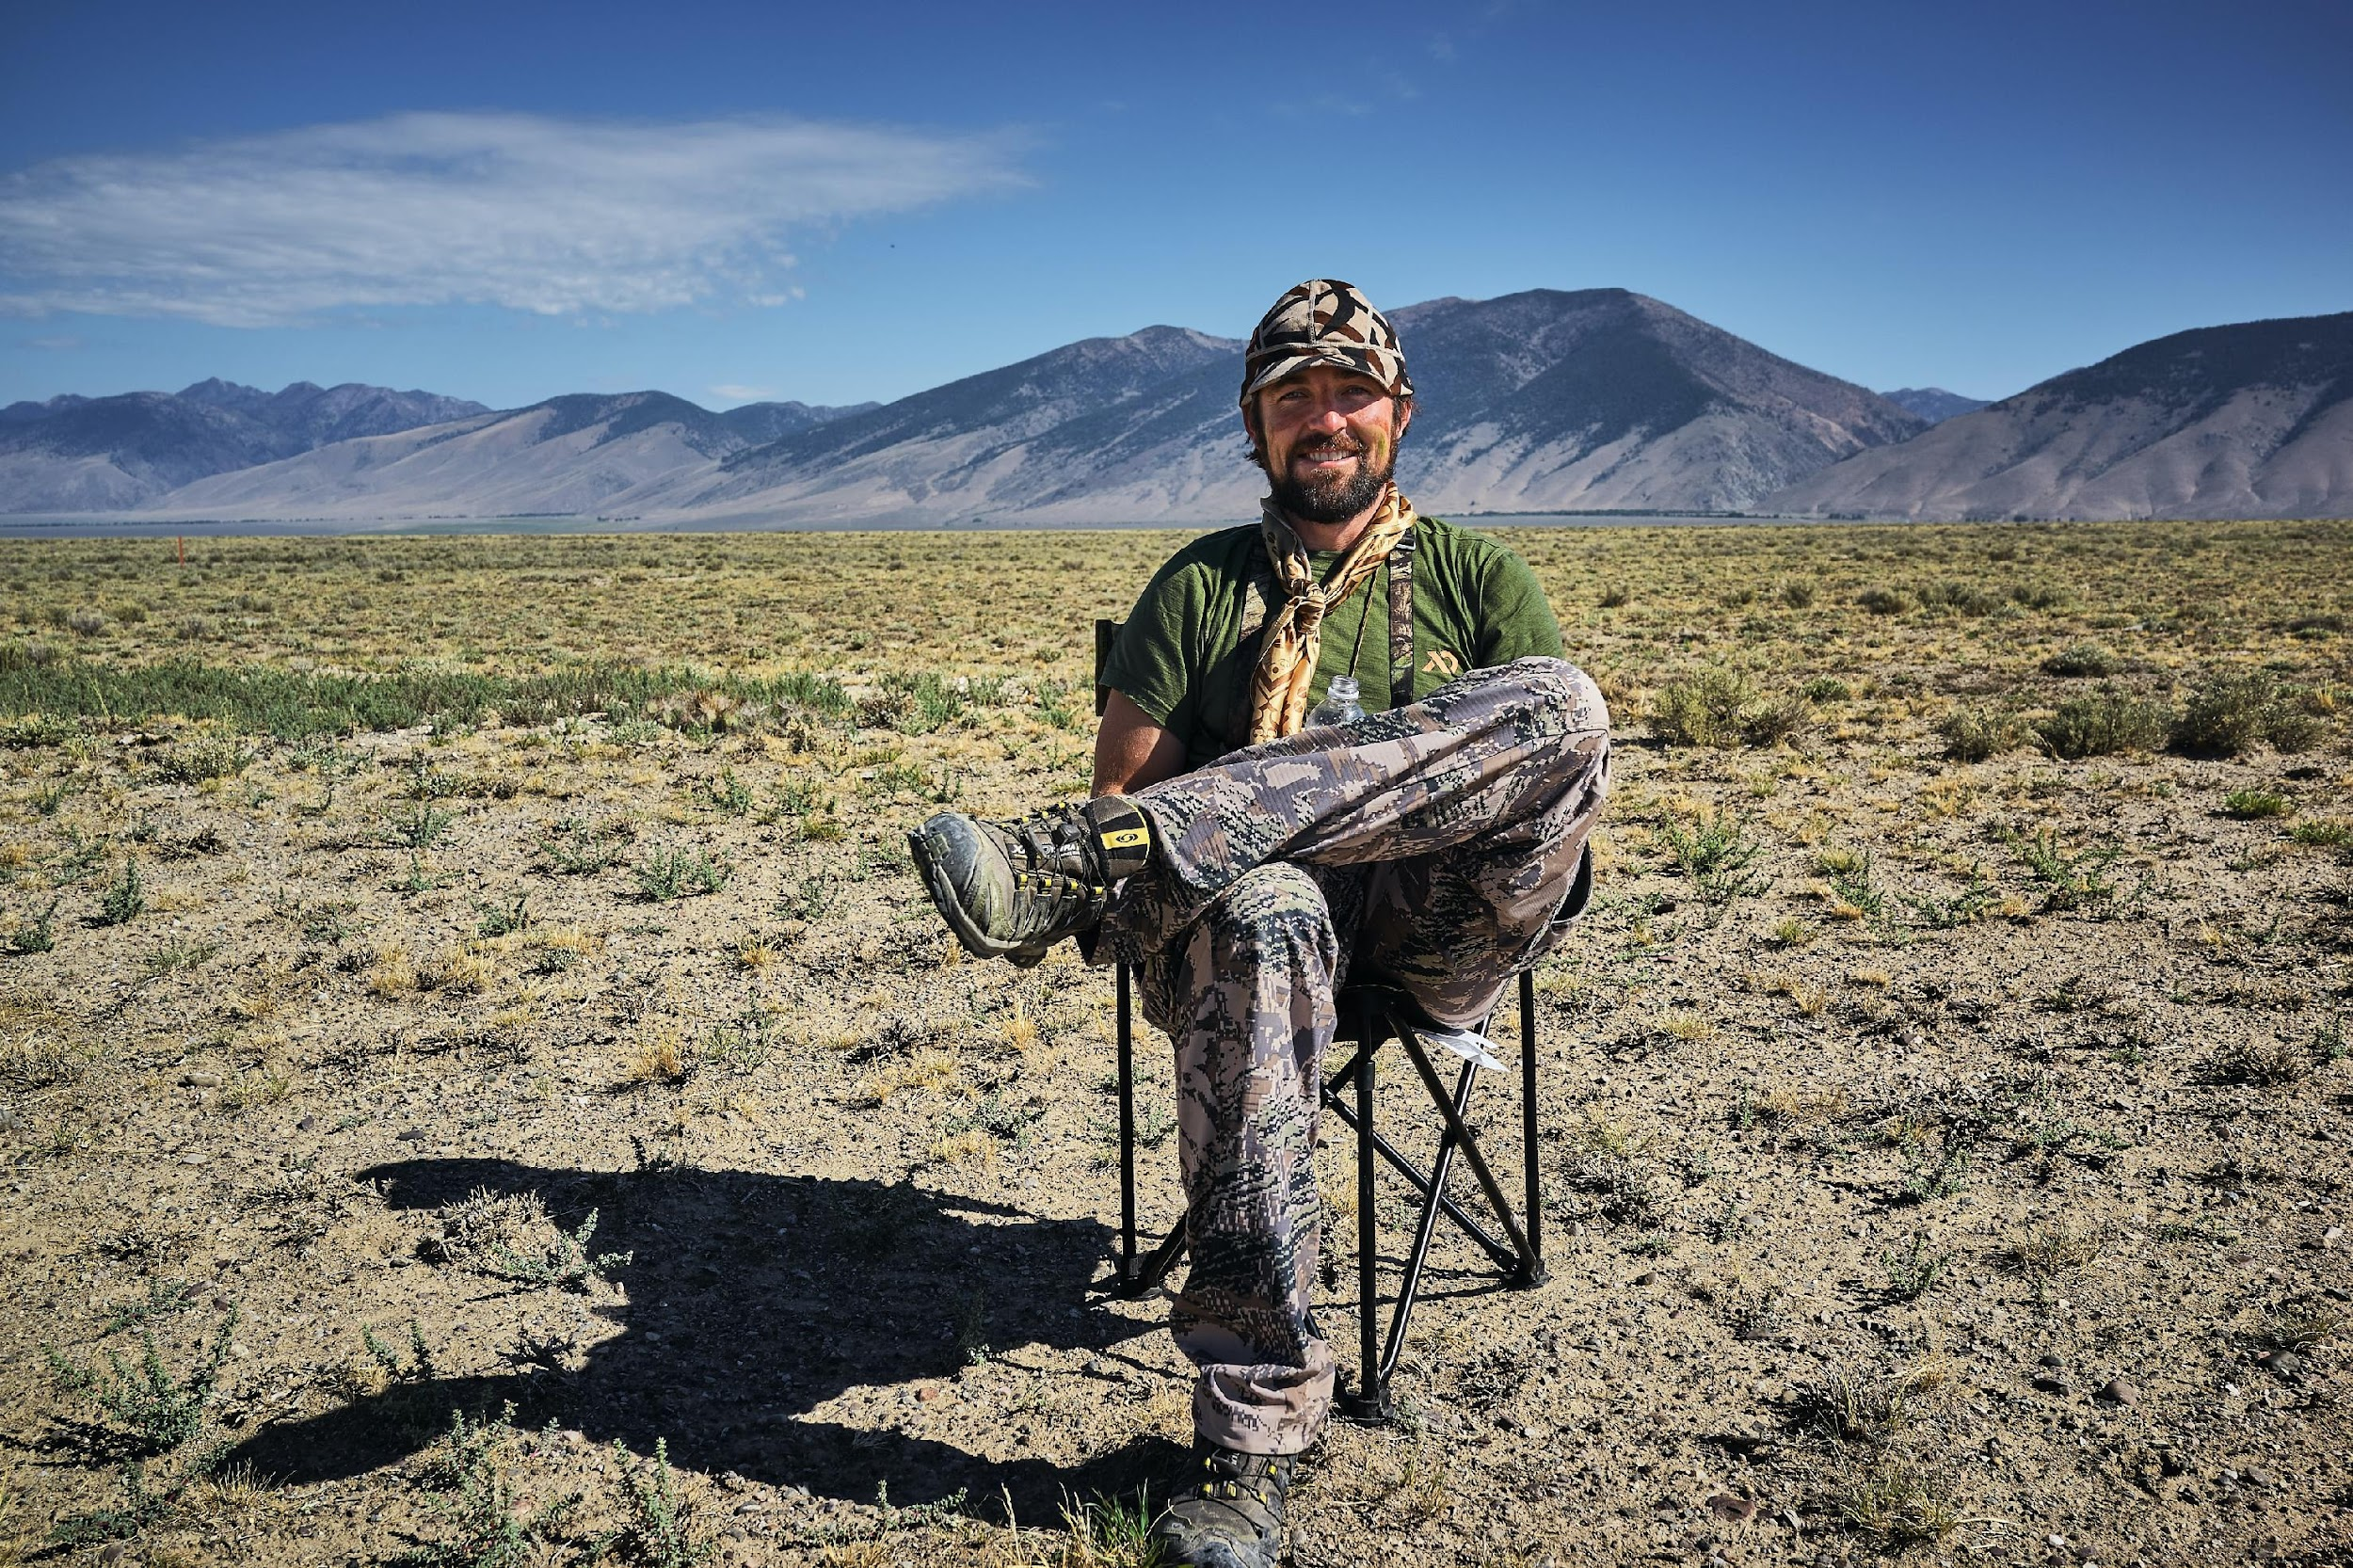
Limiting belief: Trying to do
a BIG project
Photo by vidar-nordli-mathisen
Notes:
Limiting belief
While I’m showing you the Idea Friendly Method, we’re also going to help you overcome the first limit, which is trying to do a giant project. Because their workforce challenges are so big, local leaders often try to solve them with big projects, with lots of partners, taking years to do and requiring enormous amounts of money. Like building a large new technical training center or starting a new education to career pathway. Those are undeniably good things when they work, but they are so big you can’t complete very many of them.

Slide 5
New mindset: Build your way up to big project by starting with small steps
Photo by Domenico Loia on Unsplash
Notes:
New mindset
What no one tells you is that you can build your way up to one of those huge projects by starting with small steps. When you take small steps in an Idea Friendly way, it brings you the people, the connections, and the action steps that help you make progress.

Slide 6
Gather Your Crowd
Photo by Shivendu Shukla
Notes:
Gather your crowd
Let’s walk through how to apply the Idea Friendly Method to workforce issues.
The first part is to Gather Your Crowd. You want to attract people who also care about this issue.
When economic development leaders in Brenham (BREN-um), Texas, talked to their existing businesses, they learned that their best people are skilled and loyal workers, but they just don’t have enough of those best people to meet the needs of all the businesses.
The economic developers realized they couldn’t solve such a large problem on their own. They reached out to other organizations, educators, and businesses. They started sharing their story in just one sentence: our workforce is both our best asset and our greatest weakness. That story drew people to them. They called their crowd the Workforce Maximization Group, and they started taking small steps right away.

Slide 7
Build Connections
Photo by Aaron Burden
Notes:
BC
The next part is to Build Connections. You’ve started gathering people to your idea, but they won’t automatically know how they could help. You know how these conversations go.
When I visited Colfax, Washington, an economic developer and a chamber leader told me how they wanted to increase the supply of child care for their workforce. They had talked to the school superintendent about child care, and the superintendent nodded and looked excited. Then said, “I hope you can do it!” But then they didn’t do anything to help!
I suggested that my hosts use these two questions to move people like the superintendent into taking immediate action. Ask people:
First “Who do you know who knows more about this?”
and second
“Do you have or know where to find (this resource) we need?”
Then the conversation doesn’t die with, “Good luck with that!” And people know exactly how they can help right away.

Slide 8
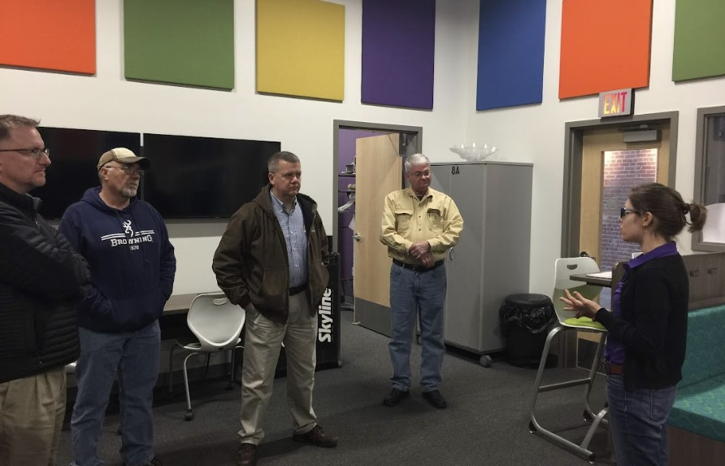
Take Small Steps
Photo by Deb Brown
Notes:
Take small steps
The last part of our Idea Friendly Method is to Take Small Steps. This is the real magic part. Forget all that big stuff for a moment and take small steps, starting with just one.
Jimi Coplen and four other rural economic developers wanted to retain more of their young people to join the workforce in Texas. They knew this was a long term issue, and one that they couldn’t solve overnight. They decided to start with one small step. They joined together to host an interactive booth at the regional career fair where young people would be gathering. Rather than talk about what economic developers do as a career, they used interactive games and selfie frames to send a message to these kids that they are welcome to stay or return to rural Texas to work. Jimi said, “Despite what they may think or are told, there really are good jobs in rural communities.” That’s a message kids need to hear over and over, and Jimi and her fellow economic developers made sure it got delivered to this group of students in a fun and memorable way.

Slide 9
Limiting Belief:
“We post job openings,
but we don’t get any applications!”
Photo by Becky McCray
Notes:
Limiting belief
Here’s the first limited belief, and it’s one you’ll recognize
“We post job openings, but we don’t get any applications!”
To overcome this old limiting belief, ask, are you overlooking potential workers by expecting them to come to you?

Slide 10
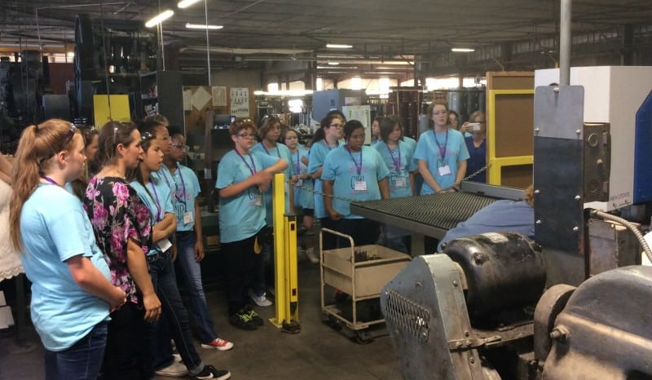
New mindset:
Go out and look for people
Photo by Kat Long
Notes:
New mindset
The new mindset is to go out and look for people you could connect with instead of waiting for them to come to you with applications.
For example, old limiting beliefs meant that girls got overlooked as potential workers in certain industries.
Kat Long, from Ponca City, Oklahoma, told us about their Girl Power Day Camp for middle school girls. It introduces girls to potential career paths in manufacturing industries and other jobs available in Ponca City right now. Kat said girls are often overlooked for many of these industry and higher wage positions.
Women from the community work with the campers on basic skills needed, take them on tours of local companies, and work with them on fun group projects. They want the girls to discover the joy in making things and hopefully help them see the possibilities for their future.
You see the new mindset at work here: rather than waiting for girls to discover these industry jobs, the industry groups are reaching out to the girls starting in middle school.

Slide 11
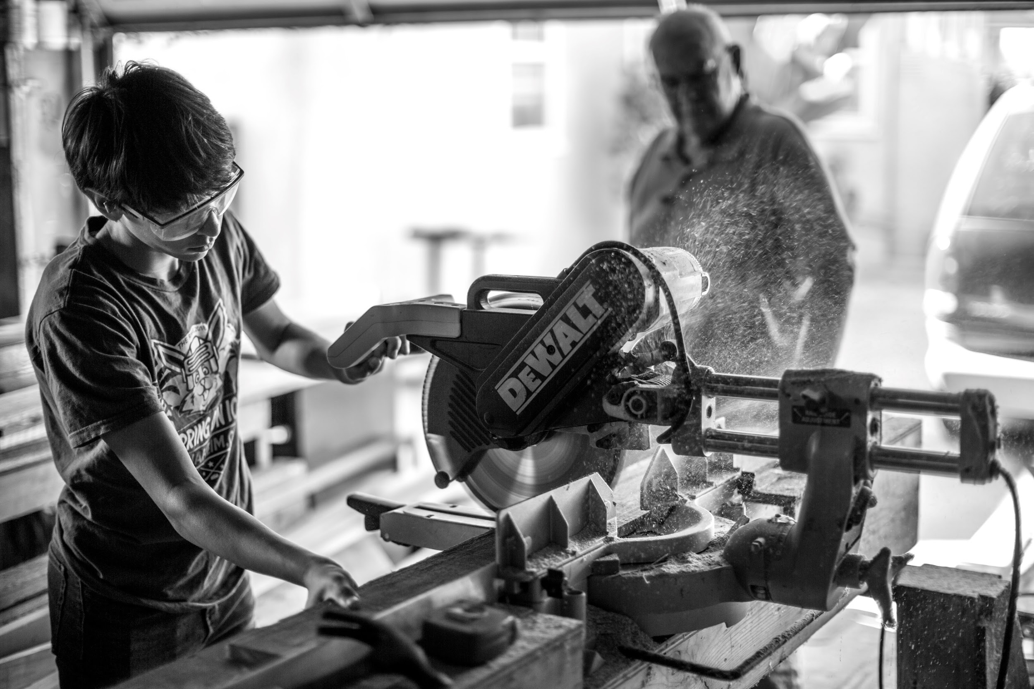
Overlooked:
At Risk
Photo by Vance Osterhout
Notes:
Overlooked
Another group that gets overlooked are “at risk” students.
Tony Guidroz, from San Saba, Texas, told me he was shocked when he found out there were 702 kids in the local school district, and more than 400 were considered “at-risk” either because of grades or language barriers. Tony wanted to give them more choices and more chances. So he shared his idea for a Blue Collar Career Fair.
He brought heavy equipment operators, an HVAC contractor, a stone mason, a plumber, an electrician, and a welder, all to one location for hands-on demonstrations. The kids could try their own hands at moving some dirt, burning some metal, or stripping some wire. Tony’s hope is to grab the attention of some kids who haven’t thought about these high-paying local jobs that are in high demand, but don’t require four years of college.
You see the new mindset at work here: Rather than employers letting grades or language barriers stop kids from applying, they’re connecting directly.

Slide 12
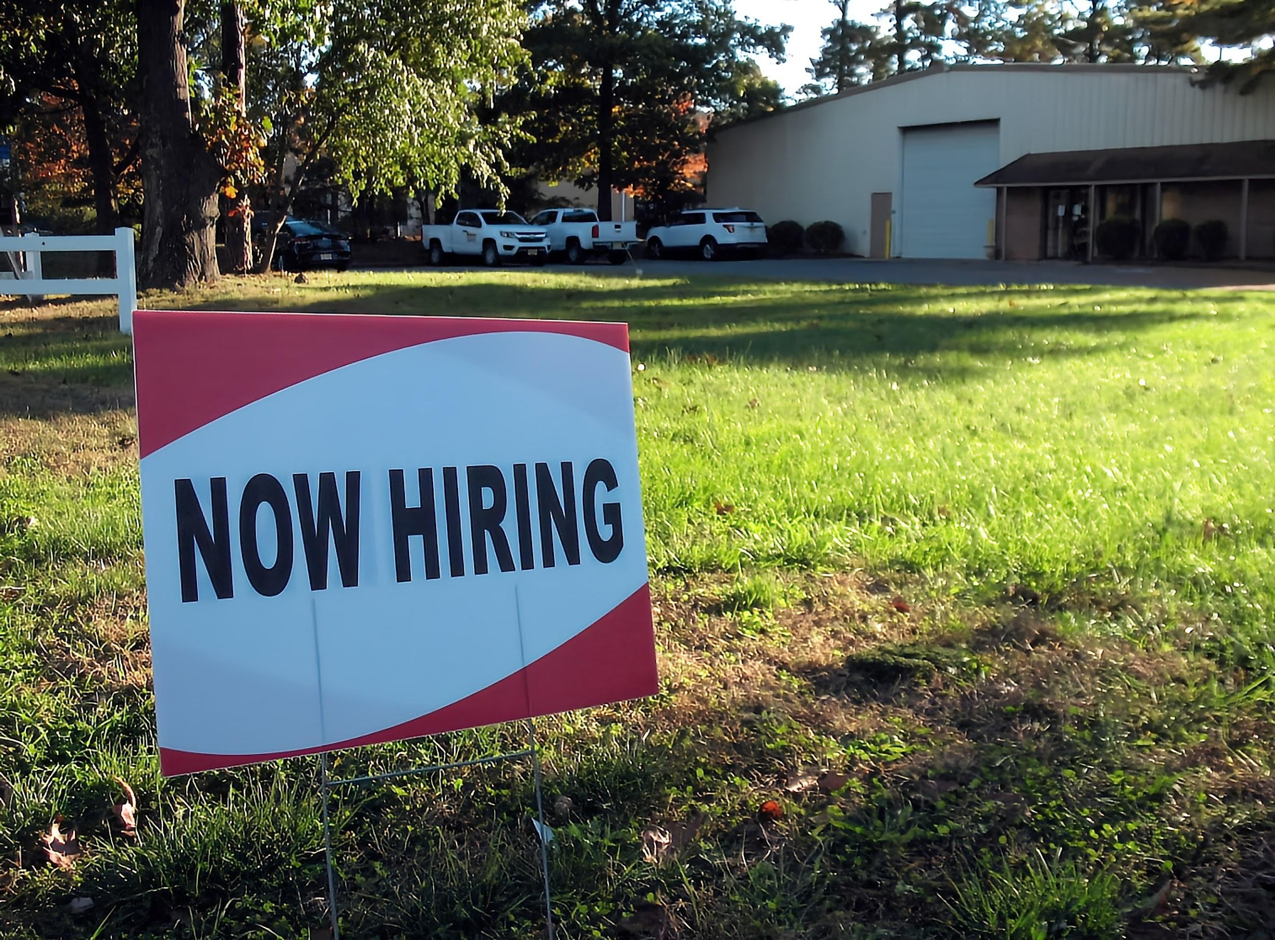
Limiting Belief:
Applicants don’t have the skills we need
Photo by Ernie Journeys
Notes:
Limiting Belief
Here’s the next Limiting Belief, that workers aren’t qualified. You’ll hear things like “Applicants don’t have the skills we need.”
To overcome this old limiting belief, ask yourself, “Am I expecting others to build my workforce for me?”
The new workforce mindset is to connect with community resources to help build the workforce you need.
If the trouble is with language barriers, find out who is teaching English classes already. It might be schools, churches or faith groups.

Slide 13
New mindset:
Connect with community resources
Photo by Red Lodge Cmty Assn
Notes:
New mindset
In Webster City, Iowa, a community nonprofit called All Cultures Equal offers English as a Second Language, or ESL, classes for adults. They have them during the day and later in the evening so people can attend around their work and family schedules. Mothers bring their young children with them too.
The school system also has a separate every day class for ESL students. They bring in employers to talk about careers in town. I spoke with these students as part of my job as Chamber Director, and I told them about lots of different places they could work in our county.

Slide 14
Limiting Belief: Hanging on to out of date job requirements
Photo by Sir Manuel
Notes:
Limiting belief
The next old Limiting Belief is hanging on to out of date job requirements.
Like, “You have to be strong to work here!”
Or “Only people with a college degree should apply.”
Or “We want people who can work shifts that change every week.”
To overcome this old limiting belief, reevaluate the requirements you have built into the job and the application process. Those high job requirements are a barrier, and you might not need them anymore.

Slide 15
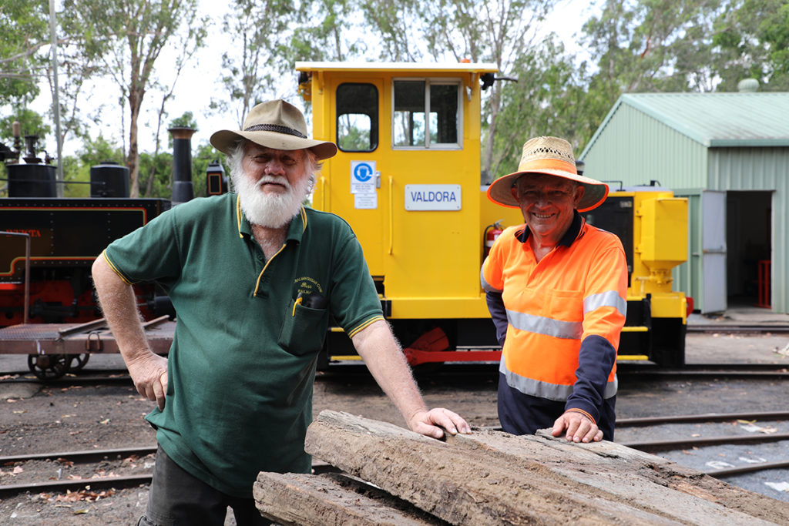
New mindset:
Break down the requirements
This Photo by Unknown Author is licensed under CC BY
Notes:
New mindset
The new workforce mindset is to break down the requirements and the work into smaller pieces that better fit the people you have available.
Elliot Lake, in remote northern Ontario, is known as a retirement town, and their population is much older than the average town. Jessie, owner of Jessie’s Towing, struggled to find younger workers who could handle the physical labor his jobs required. He decided to try hiring older workers, but it took some creative thinking. Once he modified his equipment and tools to take less brute strength, he was able to find more people who could do the work.
That’s the new mindset: literally cut down the equipment if you have to.

Slide 16
Limiting Belief: inflexible working hours.
Photo by Joshua Olsen
Notes:
Limiting Belief
Another outdated requirement is inflexible working hours.
Jessie also stayed flexible and provided shorter working hours for his semi-retired workers.

Slide 17
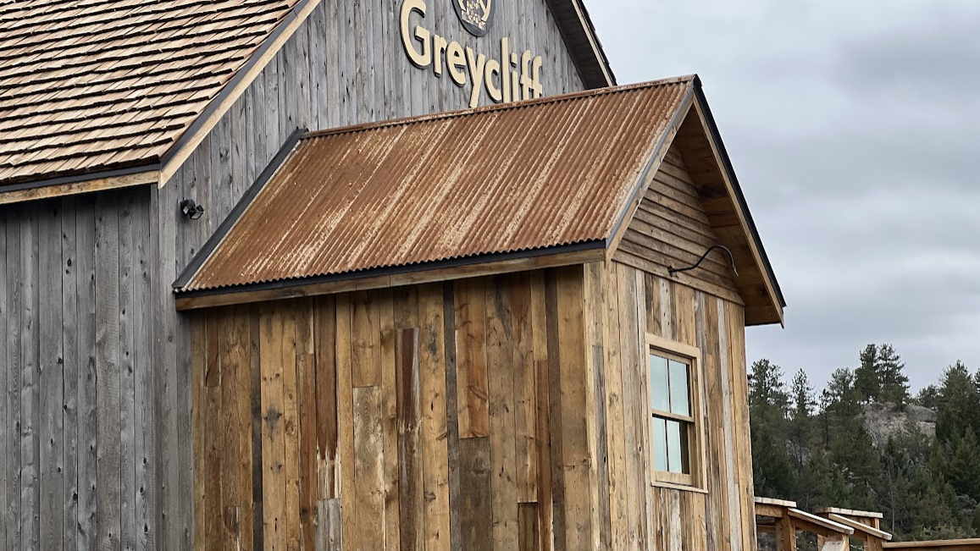
New mindset:
Temporary help
Photo by Deb Brown
Notes:
New mindset
One trend we’ve seen lately in our travels is local people working single shifts, one day a week, to help keep places open.
Raymond, a local chamber director in Big Timber, Montana, and his wife work at the local brewery on the weekends as needed. They are not permanent staff, just temporary help. It’s fun for them as they get to see many of their friends (and drink beer). It’s great for the new brewery until enough staff is hired.
This may be a temporary way to get through a workforce crunch.

Slide 18
Limiting Belief:
We can’t afford to pay better
Photo by Kenny Eliason
Notes:
Limiting belief
One of the best publicized limiting beliefs is, “We can’t afford to pay better.”
The solution may be easier than you think.

Slide 19
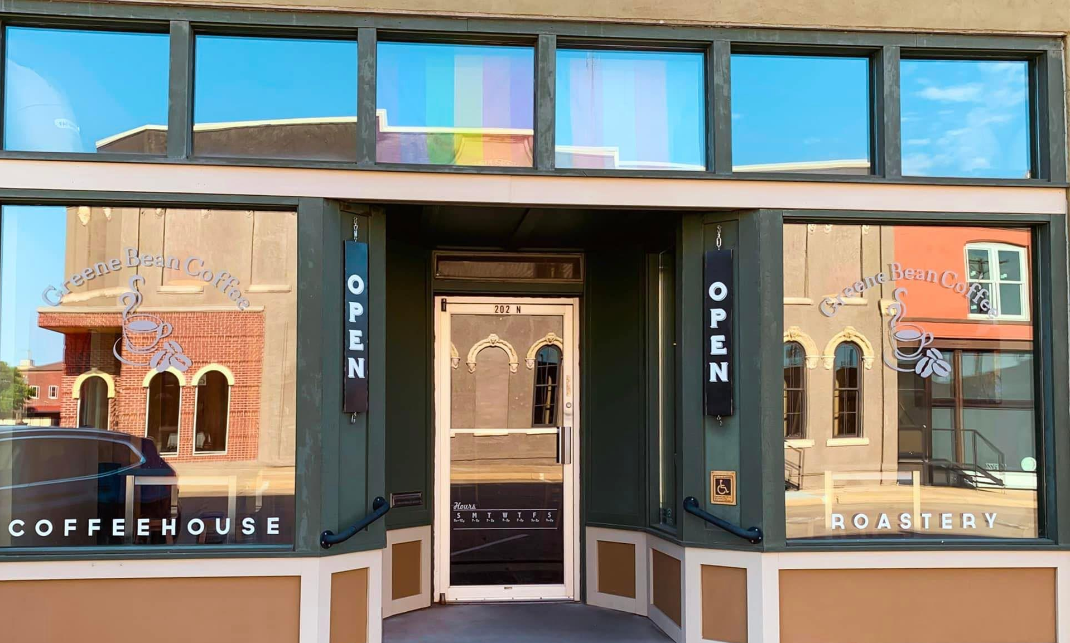
New mindset:
Value people enough to find a way
Photo from Greene Bean coffee house fb page
Notes:
New Mindset
The new workforce mindset is to value people enough to find a way.
One coffee shop in Jefferson, Iowa, was struggling to find baristas. So they tried an experiment. They raised the pay for baristas to $15 an hour. They immediately received 47 applications, with many new well qualified people. They paid for it by raising the cost for a fancy coffee by a quarter. Only 25 cents.
You see that new workforce mindset: let’s find a way.

Slide 20
Limiting Belief:
Even problem employees are worth keeping
Photo by Obie Fernandez
Notes:
Limiting Belief
Our next limiting belief is that even problem employees are worth keeping. So you’ll hear things like, “Oh, I could never fire that person.”
But when some people are creating drama or making other people leave the business, you won’t solve your workforce problem until you let them go or help them change.
We all know someone working in a local business who is driving away customers or making employee’s lives miserable.

Slide 21
New mindset:
Care about all the other people
Photo by sol
Notes:
New mindset
The new workforce mindset is to care enough about all the other people to do what you have to with that one person.
Sometimes we just have to help someone move on and find a different job that will be a better fit for them. Or find a way to help them grow into the job, or use technology to limit how much damage someone can cause.

Slide 22
Take action
Photo by Clay Banks
Notes:
Take action
When Becky and her ran a retail store, they had one of those employees who just had to have drama. She tolerated this for way too long because that person had actually worked there before they bought the business. Eventually, they noticed a serious cash shortfall, but couldn’t prove who was doing it. Becky decided to set up a new integrated point of sale and inventory system that would give them better financial tracking. It turned out, that employee quit the day before they started the new system. That freed them up to make some positive new hires.
You can use technology or training to encourage someone to move along or to limit their damage. The important thing is to take action. You’ll never solve your workforce problem when you allow one person to make things worse.

Slide 23
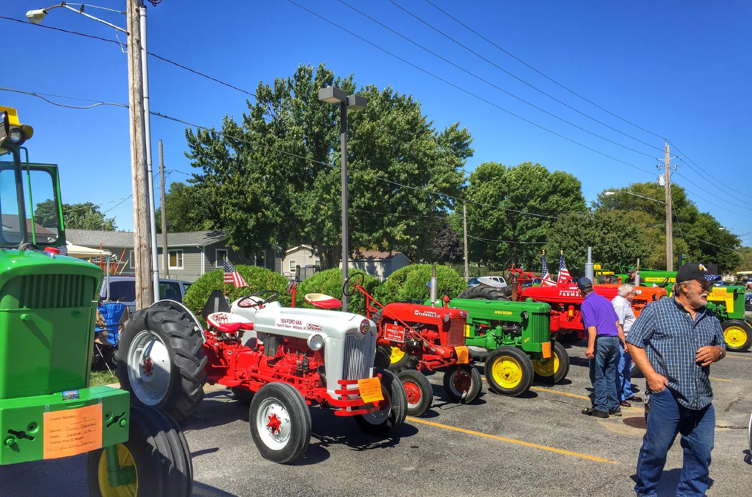
Limiting belief: We can’t do that because we’re rural
Notes:
Limiting belief
Our final limiting belief is about what we can and can’t do because we’re rural. In the past, we had to take what we could get, because we’re so far from the big cities. We’d say things like, “I wish we had that here.” or “We can’t afford that new technology.”

Slide 24
New mindset:
Keep up with technology
Photo by Deb Brown
Notes:
New mindset
To overcome that old limiting belief, ask if you are keeping up with today’s technology and how costs are dropping.
We’ve heard from plenty of rural businesses who are making more use of automation that cuts down on their workforce requirements.
Friends from Oregon told me about a local lumber mill. It has a reputation of churning through workers. No one wants to stand on their feet for an 8 hour shift of repetitive work in a noisy and unpleasant environment. Some people don’t even last a full day; they quit after their first break on the first day. This leads to comments from older managers about “kids these days” being weak, and not able to tough it out.
The same family that owns that old mill recently built a new mill in a nearby small town. It will yield just as much production, more or less, of an innovative new wood-based product. But it’s nearly all automated. Instead of 450 jobs, this mill will have 50. And instead of all those jobs being those repetitive, noisy, unpleasant and tough, most of the 50 will be cleaner, more comfortable and at a higher level of responsibility and meaning.

Slide 25
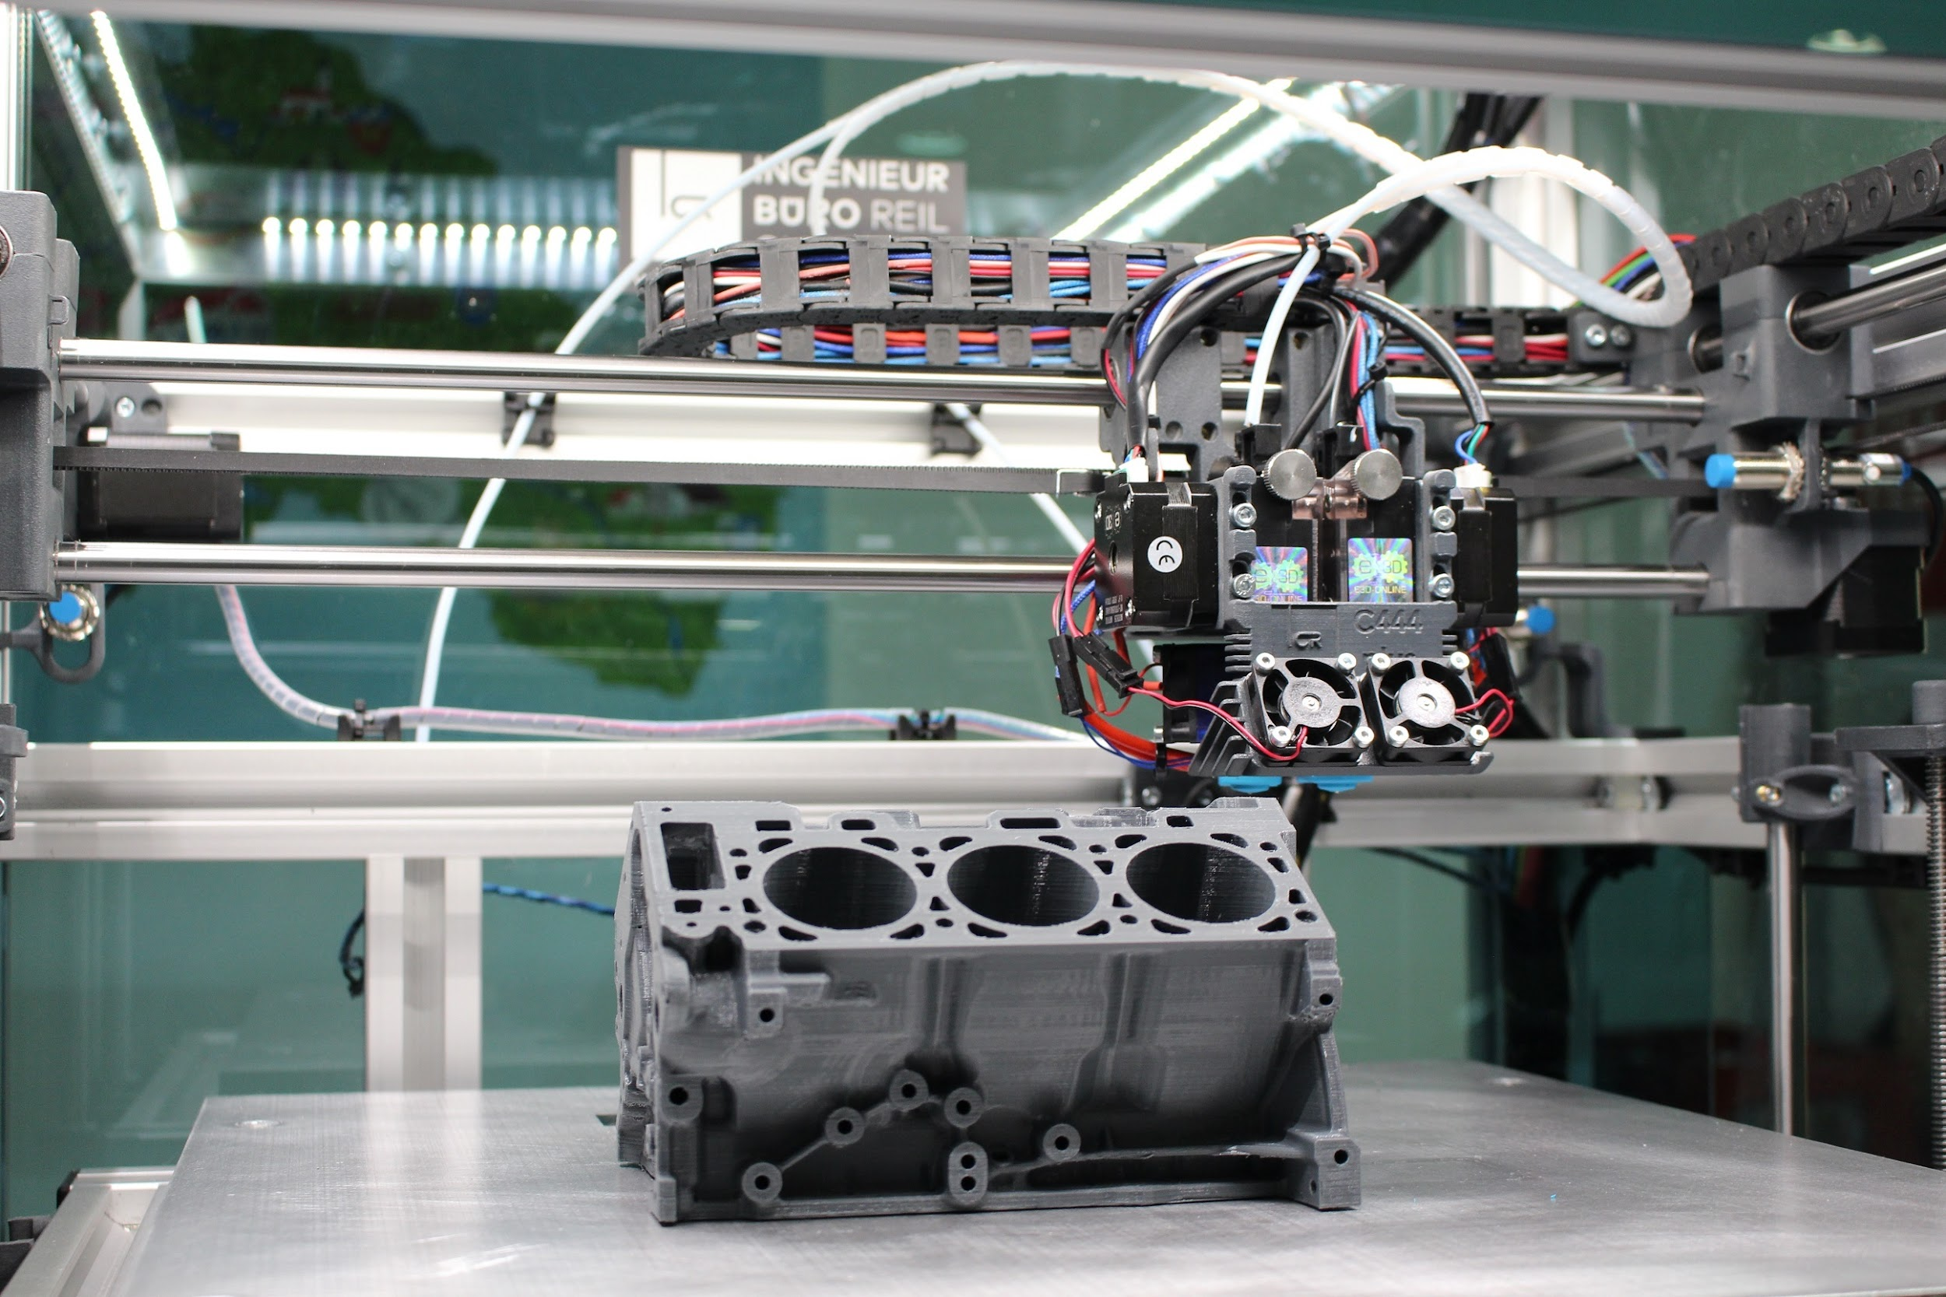
Look outside your local workforce
photo cc0 by creil91 via pixabay
Notes:
Look outside
If you can’t delegate a task to automation technology, you can also look outside your local workforce.
Our friend Cheryl Lawson from Tulsa contracts on Fiverr for certain tasks, like creating hundreds of coordinated graphics for her conferences. She calls the people she hires “magic elves” because it feels like magic to her to have those tasks completed quickly and inexpensively, and she doesn’t have to do it herself.
Did you realize that even manufacturing can now be a service like that? If you are struggling to find highly qualified machinists, you could outsource some production temporarily.
Anyone can use an app to order manufactured parts or products from small manufacturers or independent machine shops that have equipment sitting idle part of the time.
They’ll make products for you with 3D printing, computer aided machining and manufacturing, laser etching, water forming and lots of other processes using dozens of possible materials. There is no minimum quantity required. You get instant pricing and rapid delivery.
Sound like the future? Just search for “on-demand manufacturing” and you’ll find businesses like Hubs.com and Xometry doing this today.

Slide 26
Use augmented or virtual reality as training tools
Photo by ThisisEngineering
Notes:
VR
Finally, how are you using augmented or virtual reality as training tools?
You know that pilots have been training in flight simulators for decades. Now there are lots of different virtual reality, VR, or augmented reality, AR, job training examples. And costs are coming down all the time.
Health care professionals can practice performing surgery or drawing blood with virtual patients that respond to them.
Construction worker trainees can learn to work together virtually before heading out into more dangerous environments.
Augmented reality headsets or glasses can provide real-time, step-by-step instructions overlaid on the real world. Boeing already uses AR for the technicians who install and maintain electrical wiring in their aircraft. Instead of pulling out the paper wiring diagram which was literally 20 feet long, now they just look through a set of AR glasses, and they see labels right on the wiring and a precise diagram of what to do next. Boeing measured a 90% improvement in the quality of work done by newly hired technicians and 30% reduction of how long it takes.

Slide 27
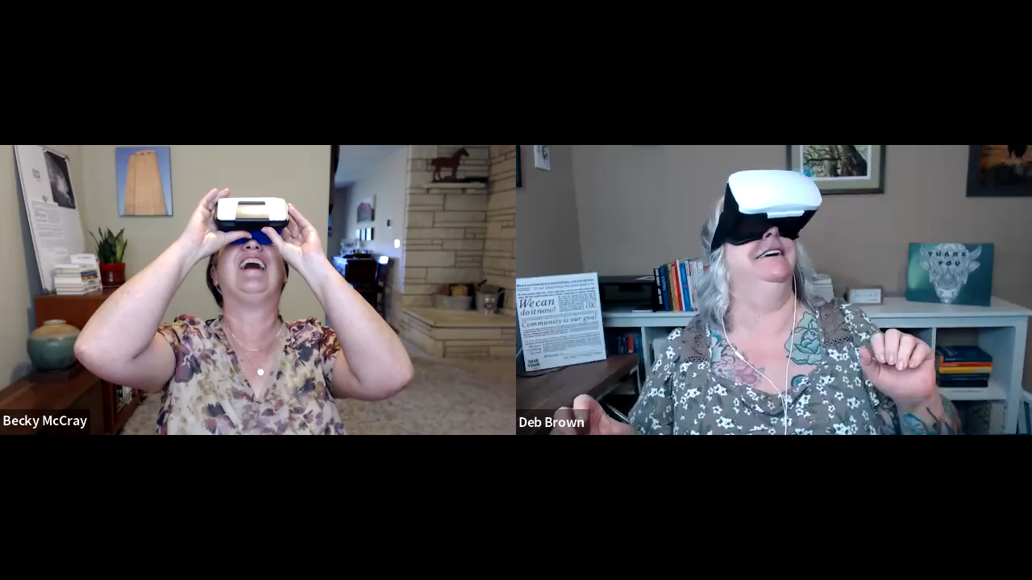
You can do this!
Notes:
You can do this
Is there any reason you can’t do things like this in your business?
And before you let someone tell you it’s too expensive, you can get a VR headset like this one for around $20. You just pop your phone into it.

Slide 28
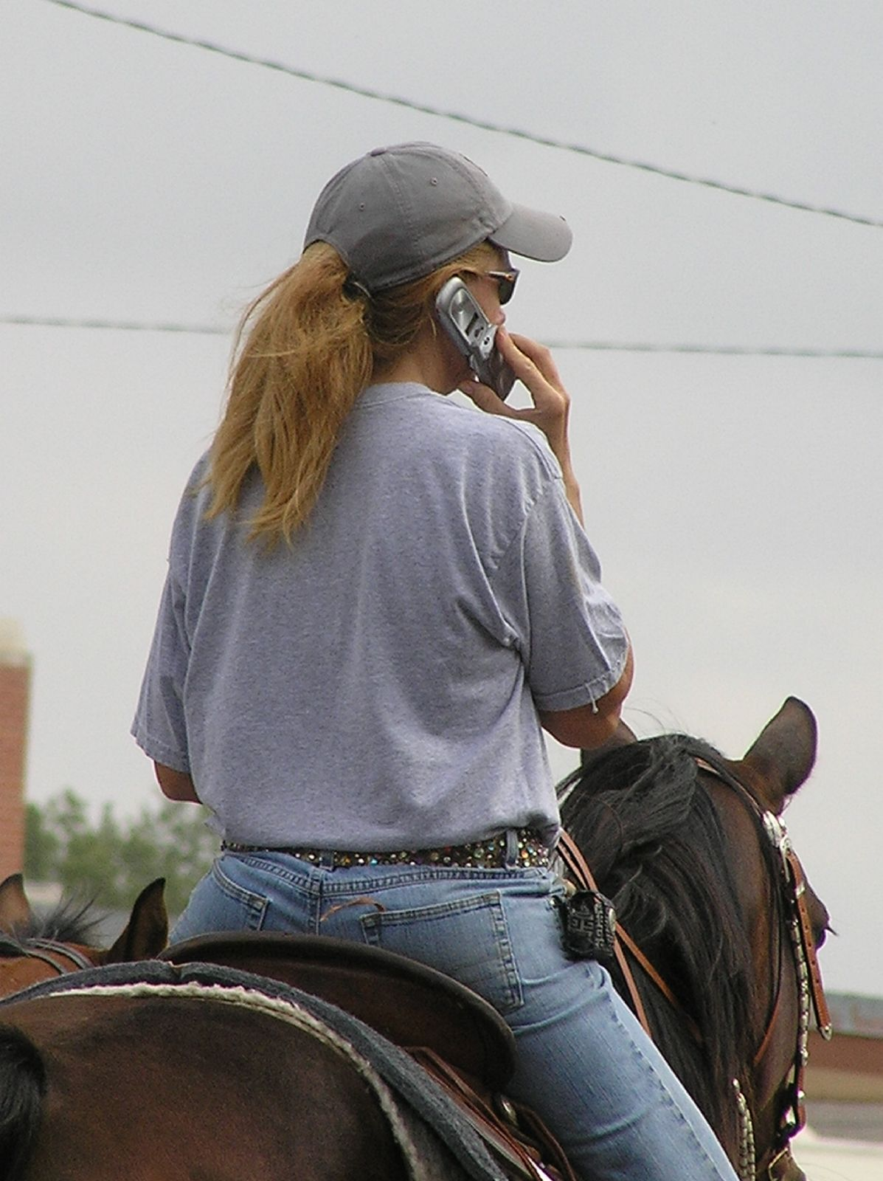
Old limits around workforce don’t have to be limits anymore.
Photo by Becky McCray
Notes:
Old limits
We do recognize that the workforce challenges you are facing may be more complex than the relatively simple stories we’ve presented today. What we would like for you to take away from this presentation is the mindset. Old limits around workforce don’t have to be limits anymore. Presume that no matter what challenges you are facing there are ways to make progress by taking small steps.
Consider some of these ideas even temporarily to buy time for more long term community based projects. Use the Idea Friendly Method to gather your crowd so that you’re not working on this alone, build connections so that you can find the resources that you need, and take small steps so that you’re not stuck in a loop of not going forward.

Slide 29
Thank you!
Receive our weekly free newsletters
www.SaveYour.Town/signup
Notes:
thanks

Slide 30
Links
Brenham Texas
Jimi Coplen
Ponca City Girl Camp
Tony Guidroz Blue Collar Career Fair
Fiverr
Hubs
Xometry
SaveYour.Town

