Slide 1
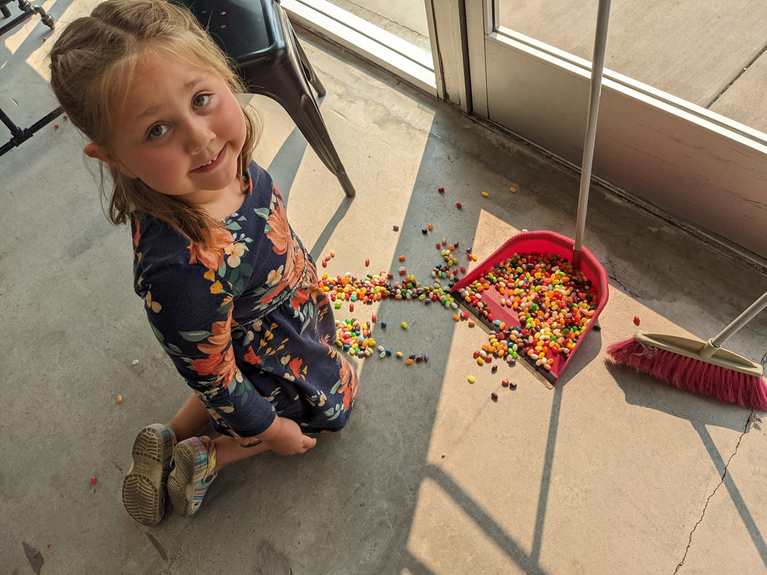
Sweet Zola’s Candy Shop
“The only disability in life is
a bad attitude”

Slide 2
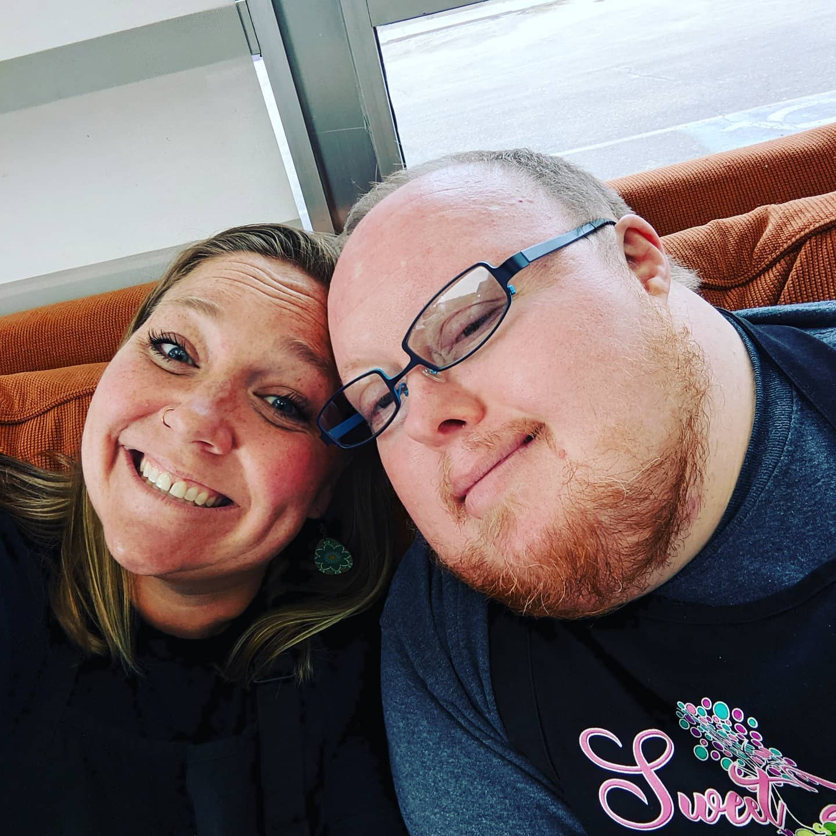
Candy For Inclusion
Employing over 30 individuals with developmental disabilities over 3.5 years

Slide 3
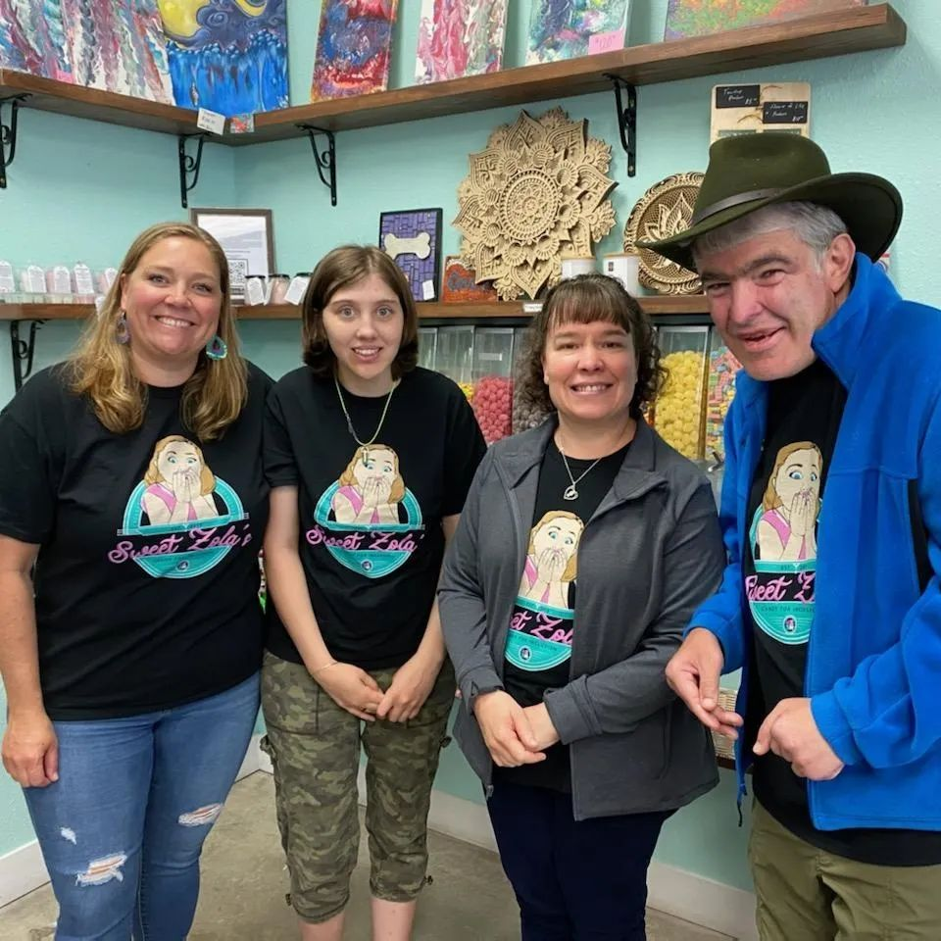
Why we did it and who benefited
The story behind opening

Slide 4
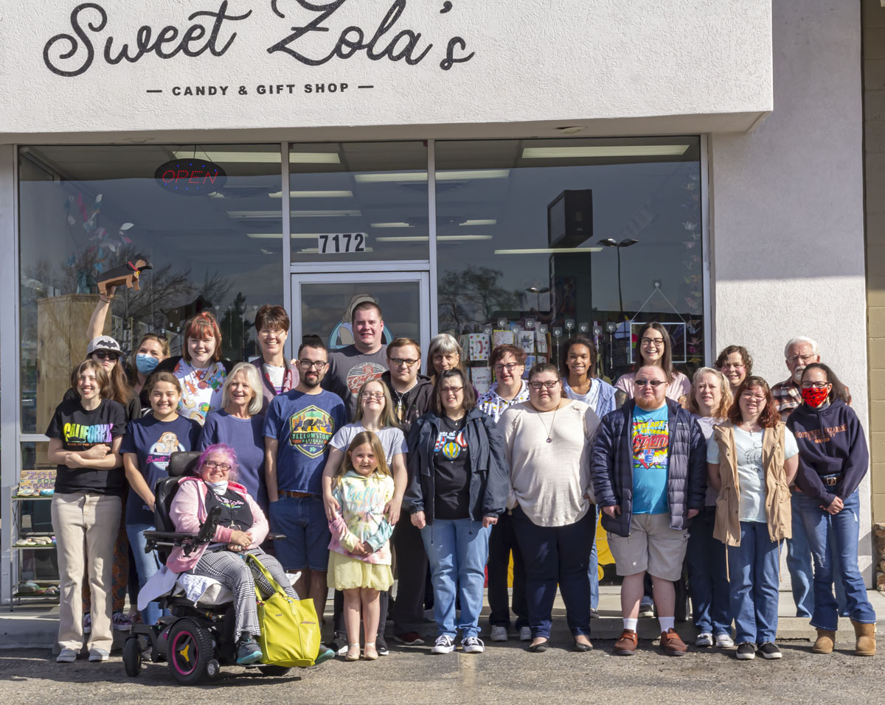
How the project is sustained
Full time work outside of the shop
Community involvement
Grants
Yard sales
Art shows
Local artists

Slide 5
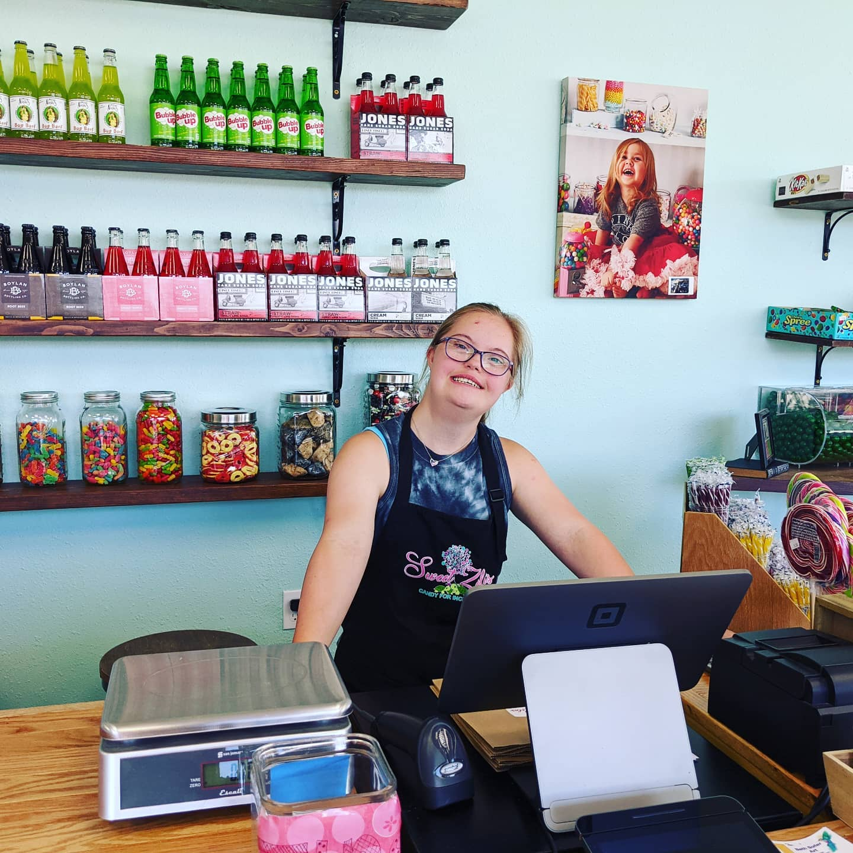
Overall community benefit
Providing employment to individuals with developmental disabilities
Creating a community
Providing a safe place
Making friendships
Providing socialization

Slide 6
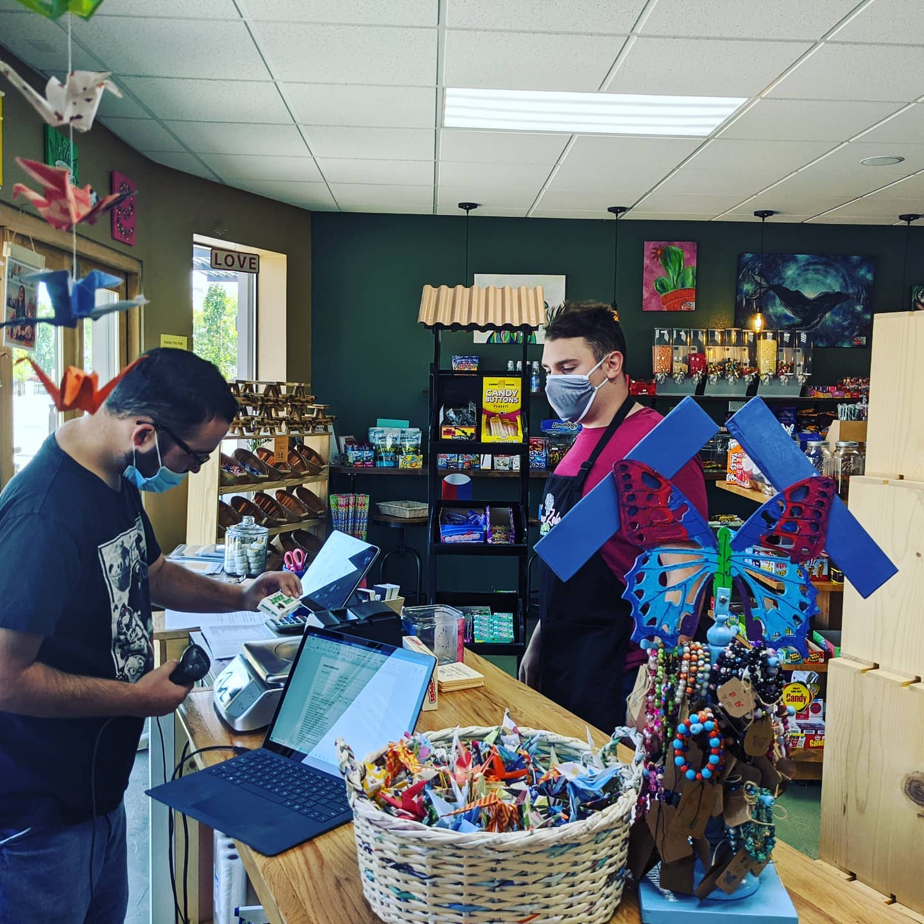
Lessons learned that could help other communities
Fundraise first
Find volunteers
Questions?

