Slide 1
“The Sunrise Wyoming Project”
Skilled Trades Camps
Presented by:
Troy Reichert
Key partners of project:
Harbor Freight Tools for Schools Wyoming Department of Education
University of Wyoming Wyoming Business Alliance
Wyoming SkillsUSA SHAPPS
The Daniels Fund AGC of Wyoming
King Ropes Platte County Chamber of Commerce

Slide 2
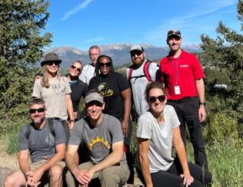
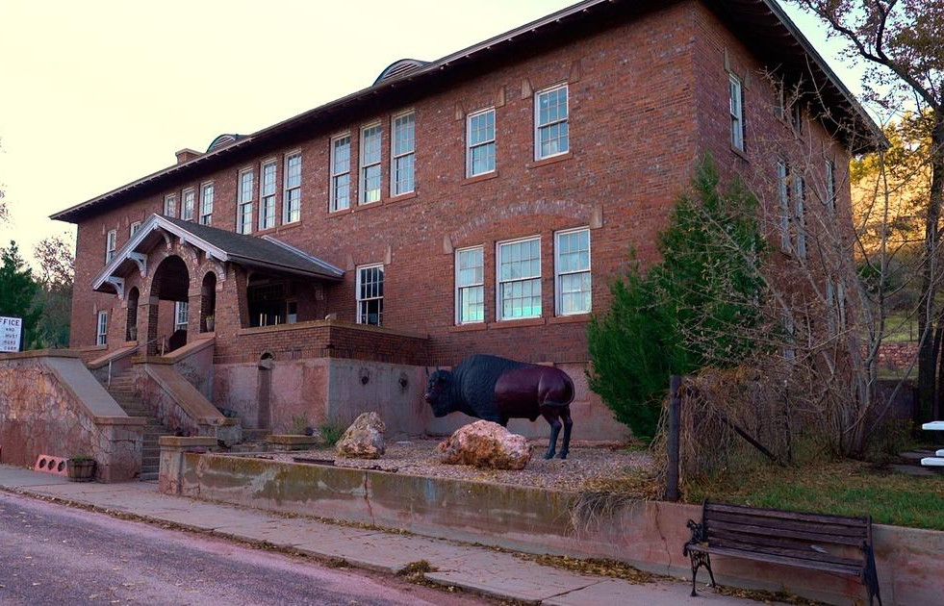
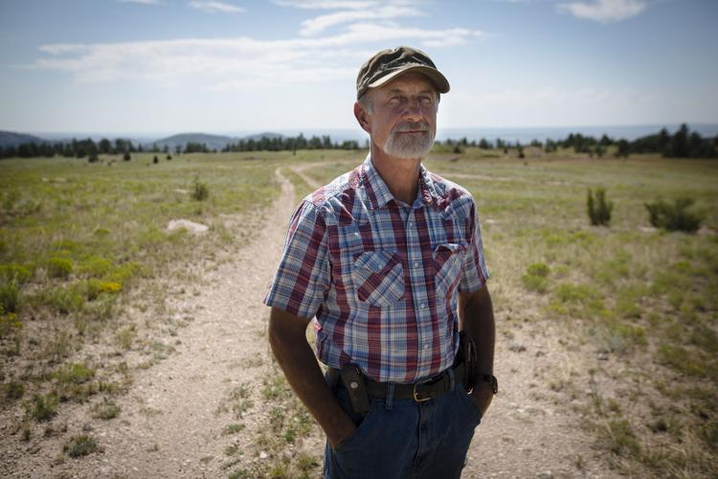
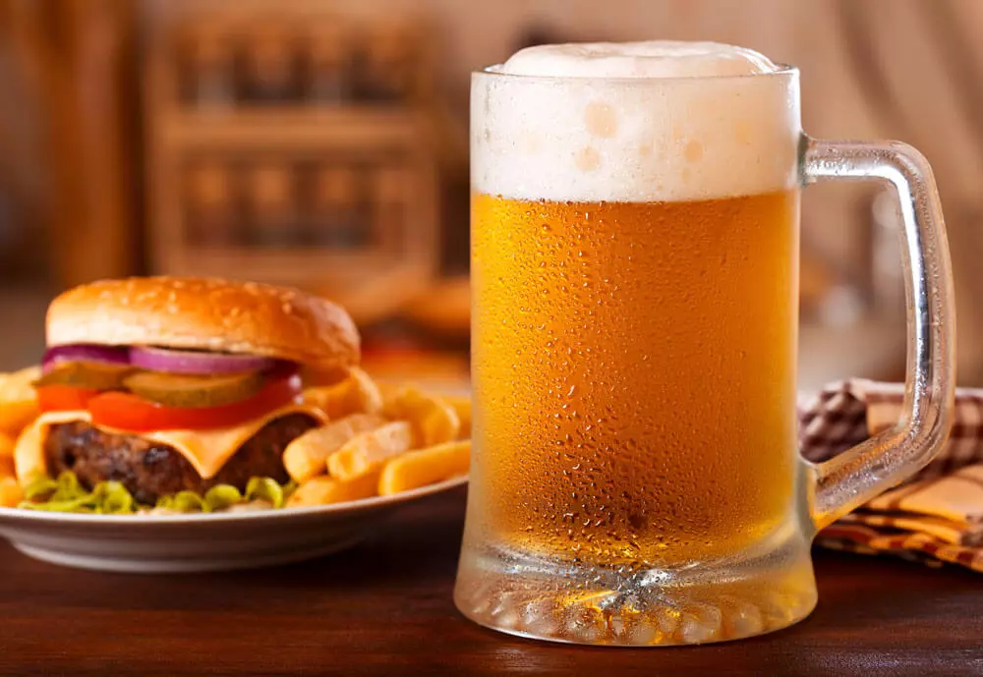
HOW IT ALL GOT STARTED:

Slide 3
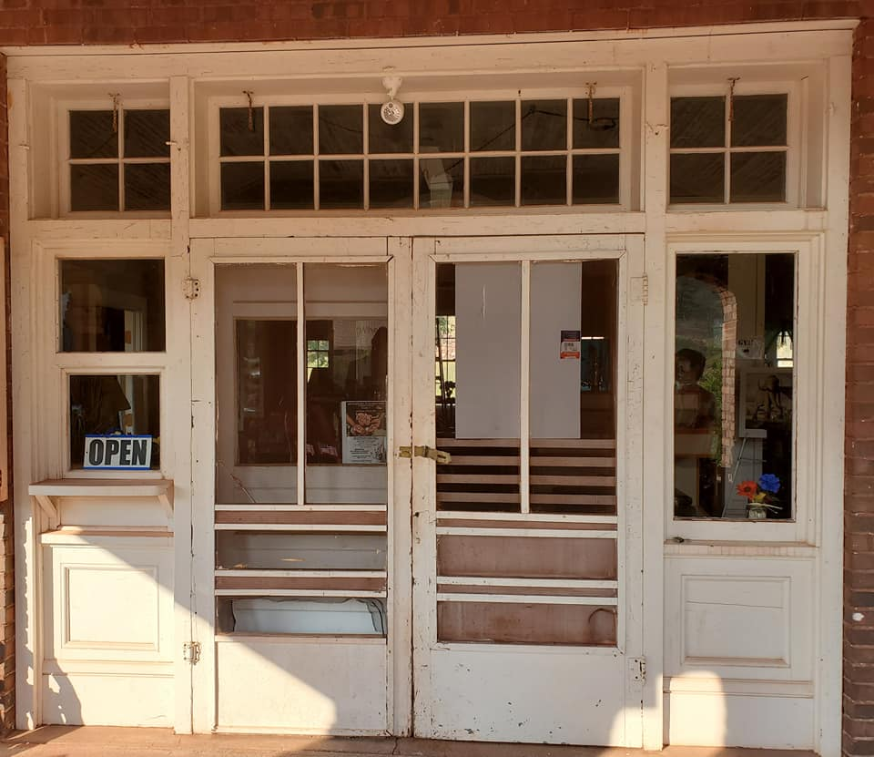
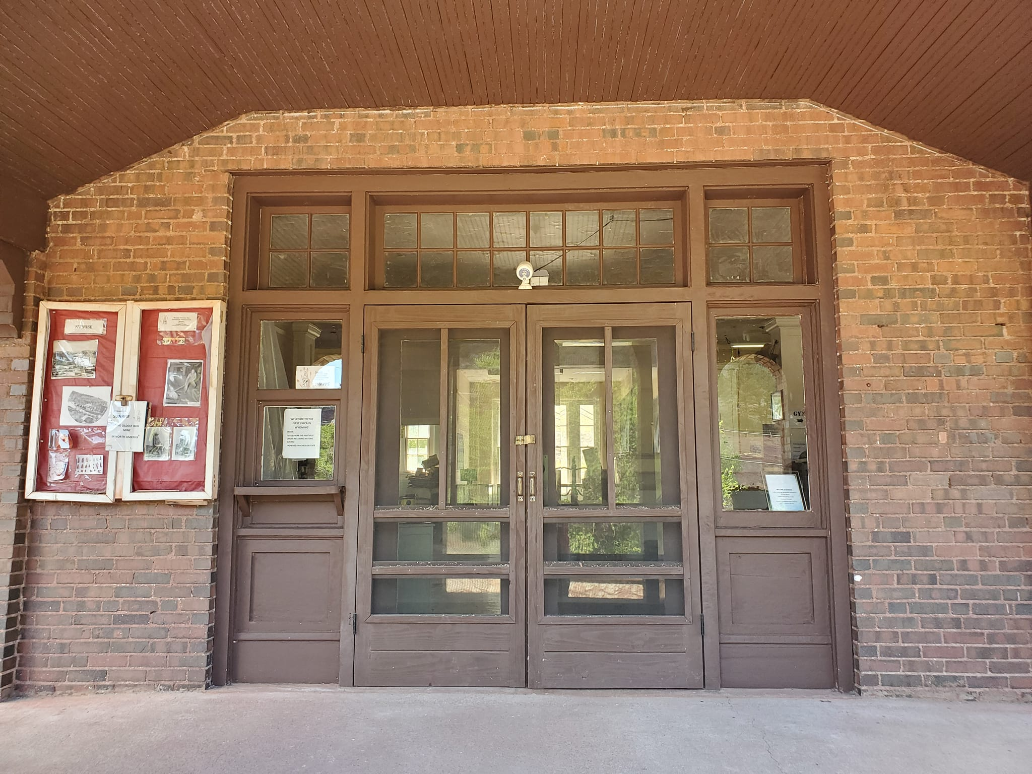
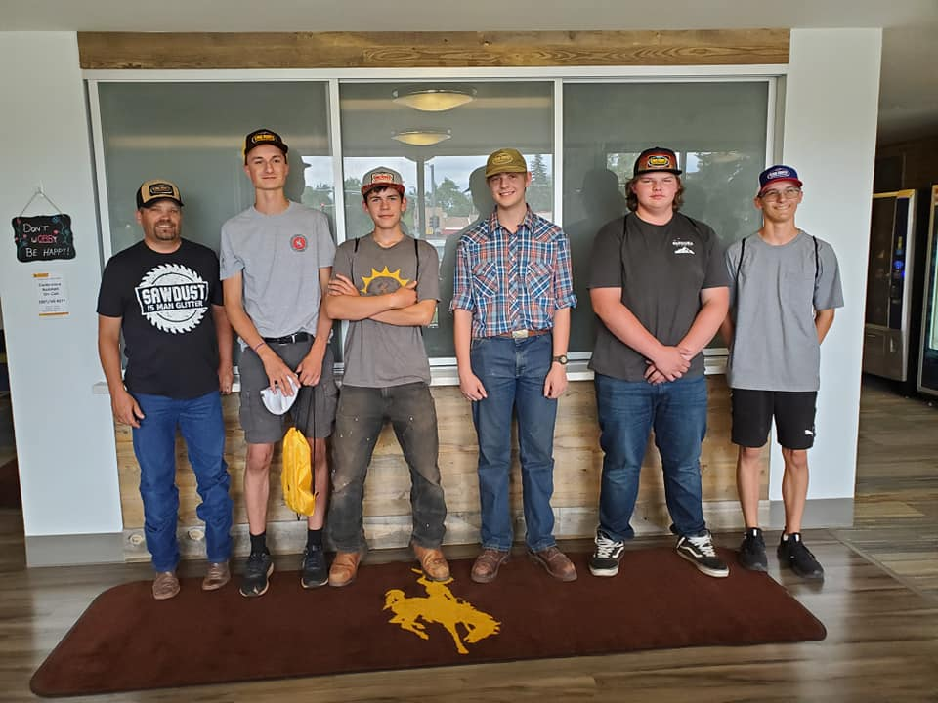
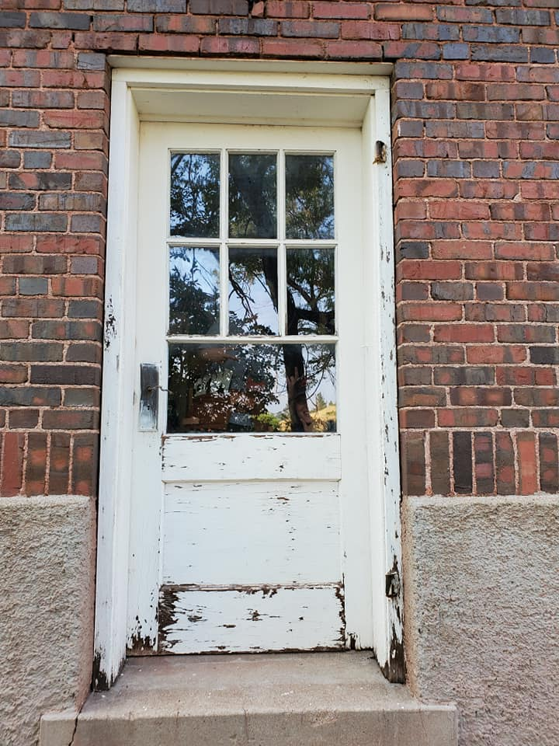
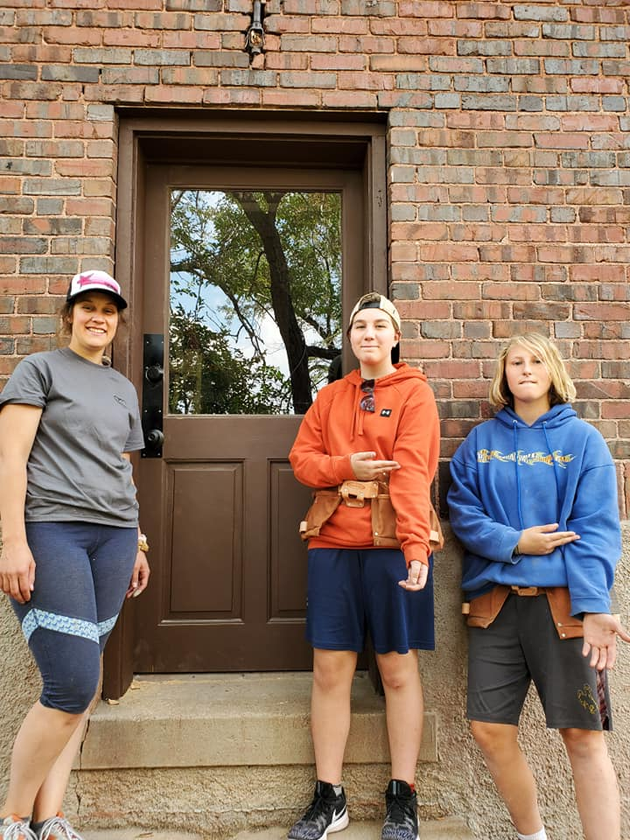
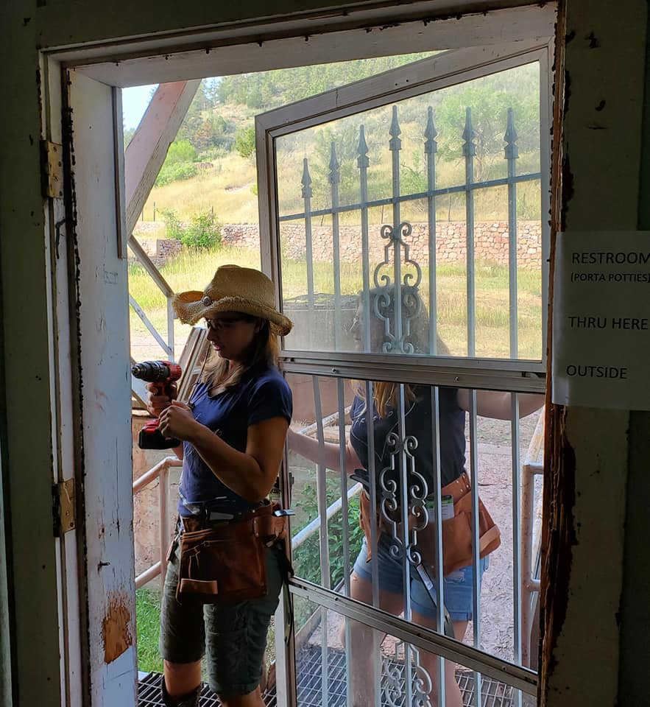
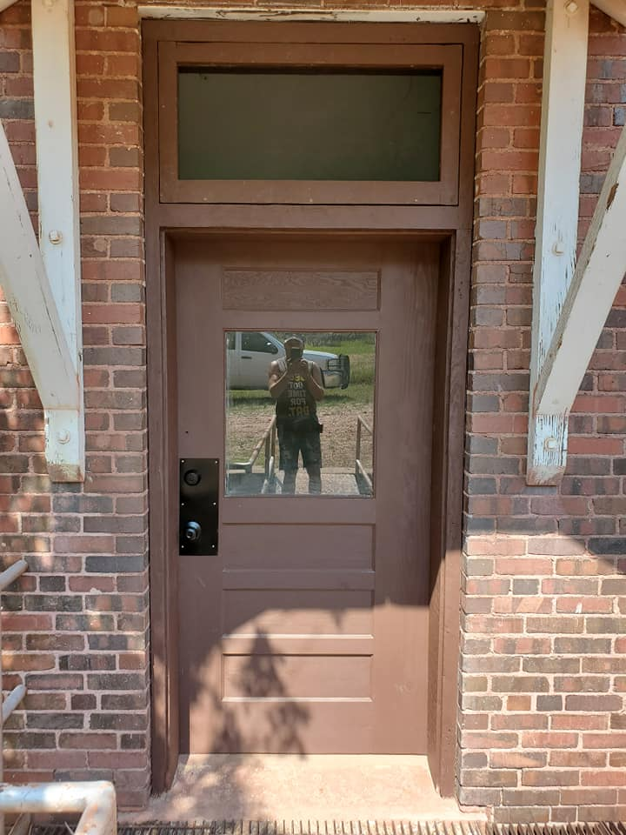
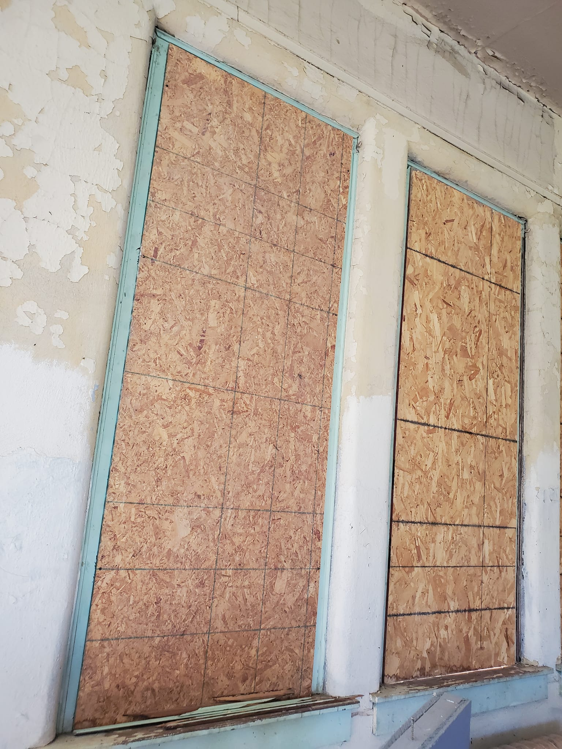
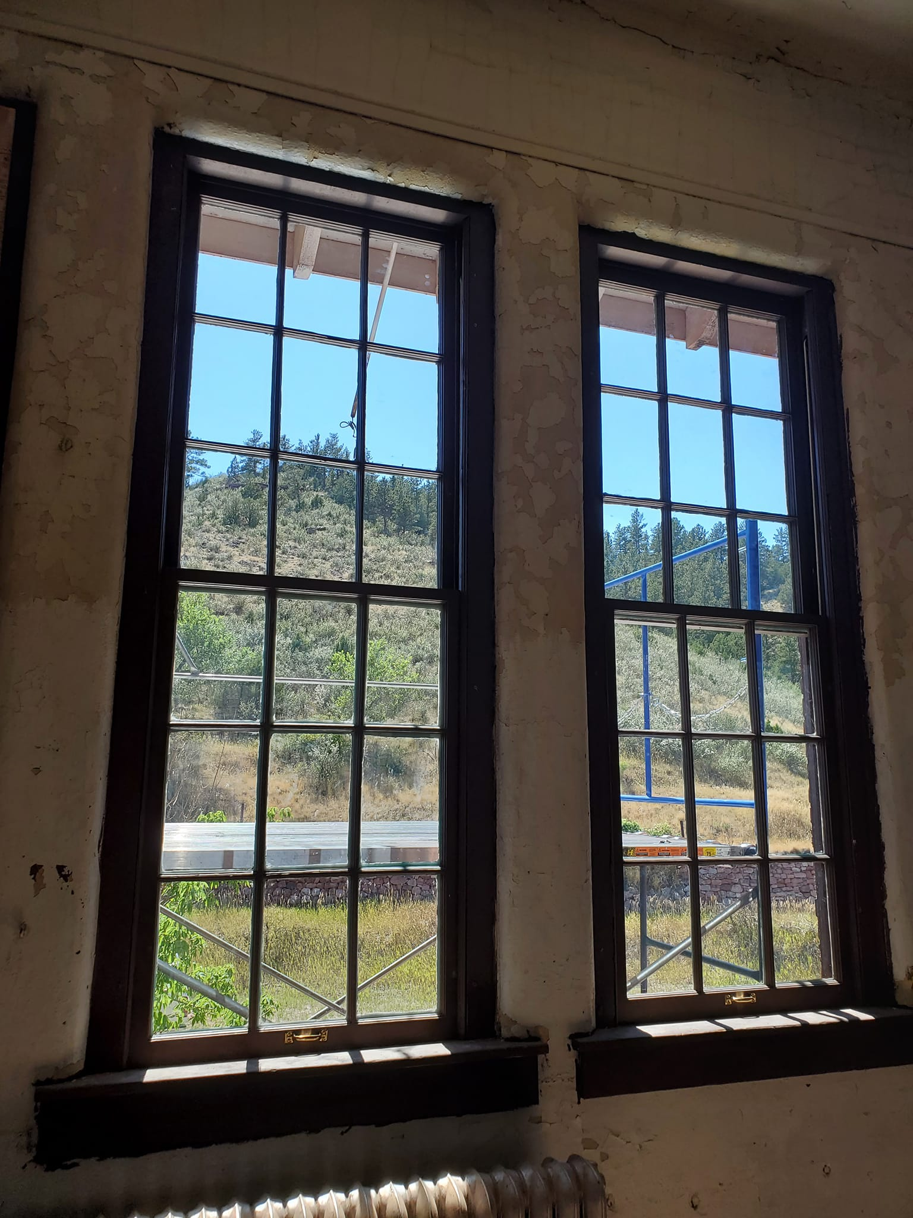
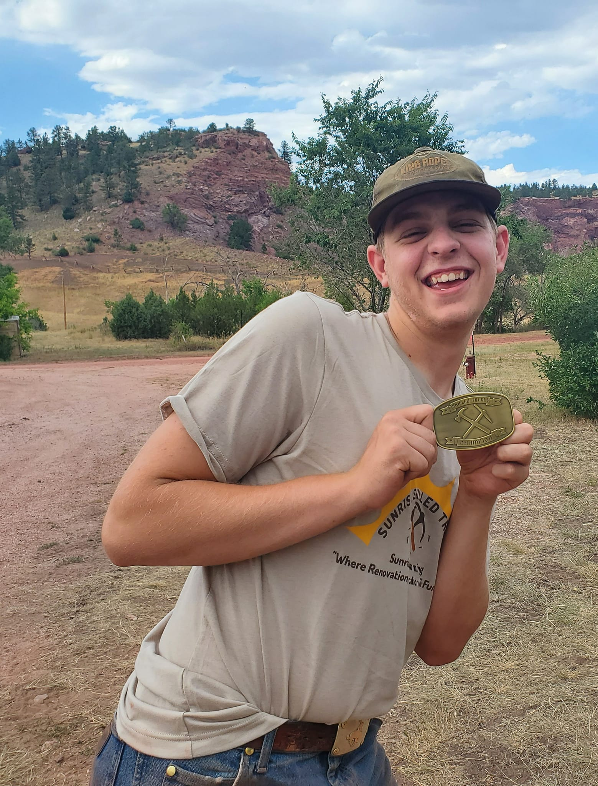
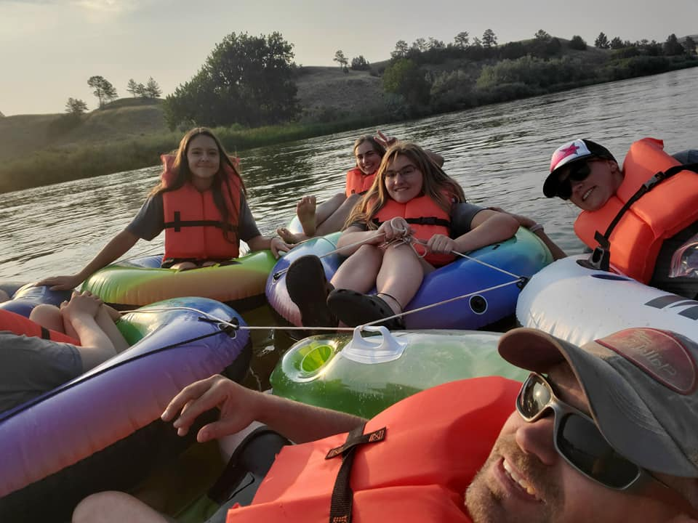
WHO BENEFITED AND HOW WE GREW
Facebook: The Sunrise Wyoming Project

Slide 4
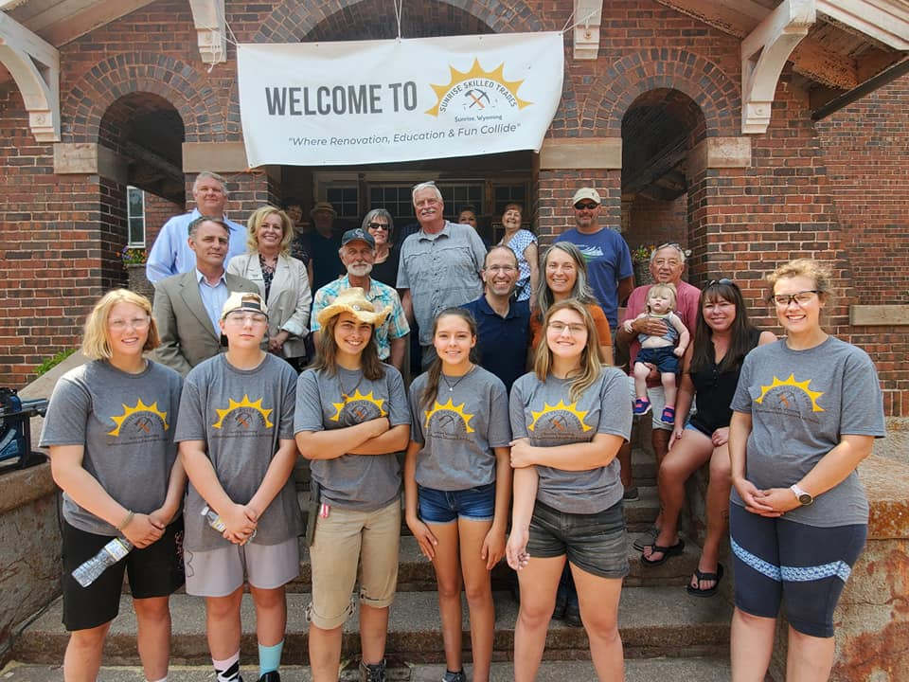
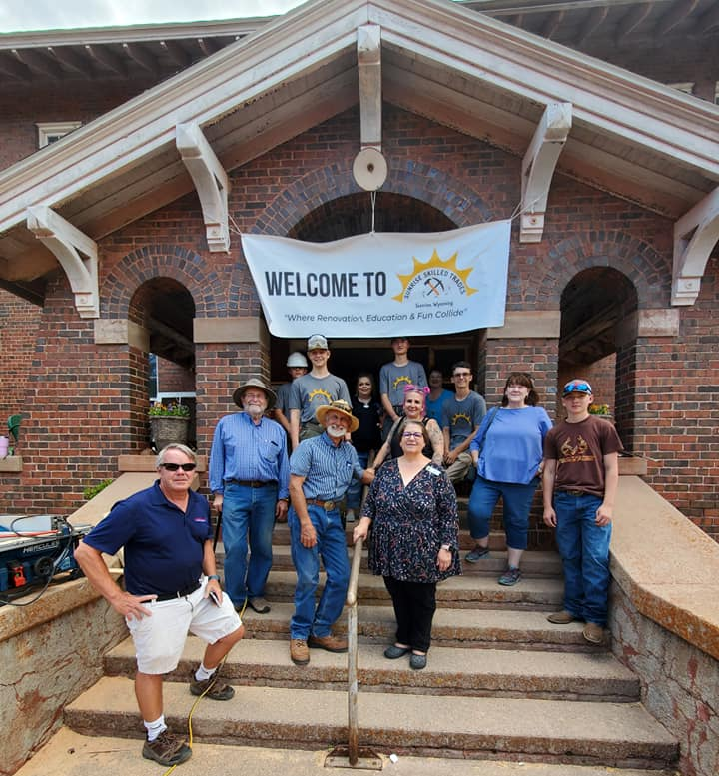
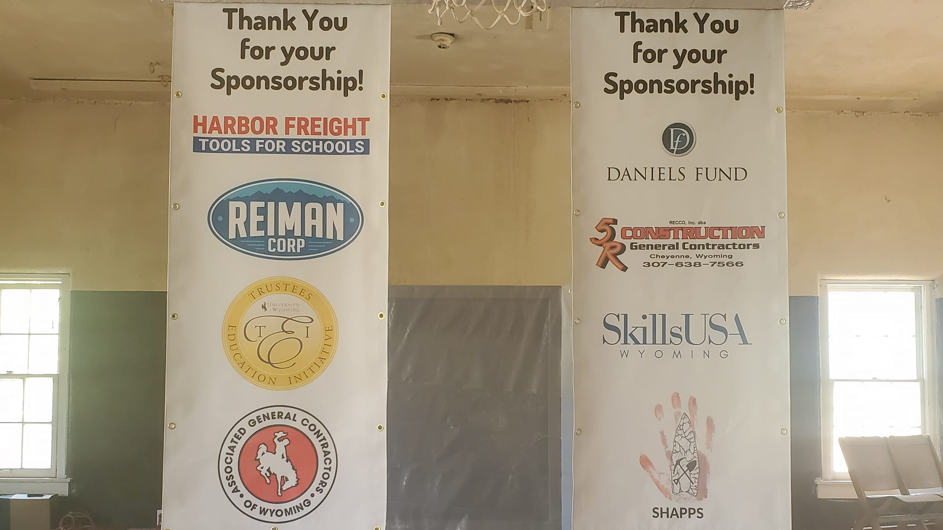
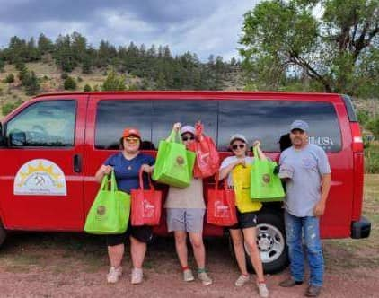
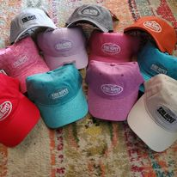
PARTNERS AND THEIR ROLES

Slide 5
HOW CAN OTHER COMMUNITIES DO THIS?
GET OFF YOUR …. AND DO IT
BUILD RELATIONSHIPS
DREAM BIG & TAKE CHANCES
ASK FOR HELP
APPLY FOR GRANTS
PROMOTE AND ADVERTISE (articles, social media, TV, open houses)
MAKE SURE PARTNERS SEE BENEFITS
STAY IN TOUCH AND BE APPRECIATIVE
KEEP IT FUN!

Slide 6
HOW THE PROJECT IS SUSTAINED
Grants and donations to get started
Set up partner levels
goodie bags, T-shirt sponsors
Red Ochre level
Iron Ore level
Copper level
All levels come with “perks” for the business.
Keep it fun for kids! They’ll sell it if they like it.
Invite people to come see the project for themselves!

Slide 7
OVERALL COMMUNITY BENEFIT
Invigorates others in the community to want to help
creates more pride in the community
Evening activities and UW trip bring money in to the community.
Could bring young people/families to the area
3 seniors from PA are considering moving to Wyoming for work after high school
Builds a strong bridge between people of all ages
students see the importance of improving skills and preserving history
older community members see that kids can and will work
Keeps quality skilled workers in the area instead of moving away.

Slide 8
LESSONS LEARNED THAT COULD HELP OTHER COMMUNITIES
Get infrastructure in place first
can be done later, but it’s EASIER to implement it first
Stay organized and utilize dependable help
Always have a backup plan
Be prepared to spend your own money
sunrisetradescamp@gmail.com
307-331-5423

